Slide 1
Working with Subrecipients, Consultants, and Vendors
OSP Awareness
SPONSOREDPROGRAMS.syr.edu
ospoff@syr.edu

Slide 2
Collaborating with External Parties
Today’s Topics
Proposal Development and External Collaborators
What do you need?
Types of Collaborators -
Subrecipients –
Contractors – Consultants, Vendor/Purchased Service
Stewardship of Sponsored Funds
Complying with University Policy and Uniform Guidance
Third Party Engagement Form
Formalizing the Relationship
Subaward
Consulting Agreement
Purchased Service

Slide 3
Proposal Development
What do you need from your Collaborator
Work with your Research Administrator and follow proposal guidance related to requirements for external collaborators; i.e., letters of intent, Statement of Work, Budget and budget narrative, rate agreements, key personnel CV...
At minimum you will need:
Documentation Authorizing Collaboration on the Project
Simple statement from the collaborator committing to participate in the research (i.e., Letter of Intent or Commitment Form)
Must be signed by an authorized official
Statement of Work/Description of Work to be Performed by the third party
Budget and Budget Justification including Cost Estimates for the performance of the Statement of Work
Identify what type of Collaborator you are engaging

Slide 4
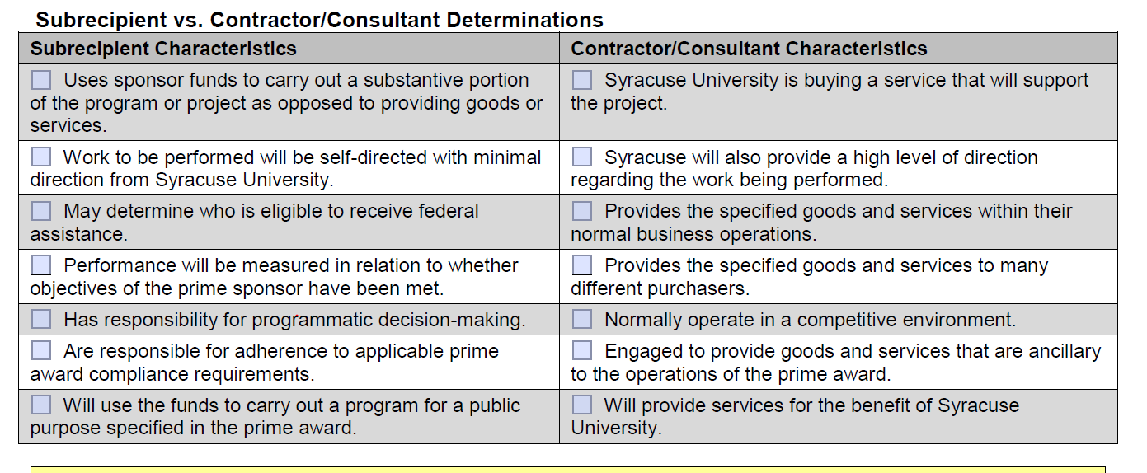
Types of Collaborators
Making the Subrecipient/Contractor Determination
The table below outlines characteristics associated with each type of collaboration
This determination can be challenging and requires specific knowledge regrading what kind of work/service the collaborator expected to provide.
It is helpful to make this determination at the proposal stage as the decision will impact the budget.

Slide 5
Stewardship of Sponsored Funds
University Purchasing Policies
The University’s goal for every purchasing transaction is to obtain the best value.
University Purchasing Policies define rules regarding purchases using sponsored funds including when competitive bidding is required.
General policy requires documentation to support the –
basis for the Subrecipient/Consultant/Vendor selection,
justification for a sole source selection or non-competitive purchase, and
basis for the price of the purchase.
OMB’s Uniform Guidance, 2 CFR 200
Federal regulations (2 CFR § 200.319) require that procurement transactions, including those engaging expert collaborators, be conducted in a manner providing full and open competition, except in the case where sole or single source (non-competitive) proposals are justifiable.
All Sole Source Selections Must be Documented
Some purchases can be exempt from the required competitive bidding requirements.
Services from only one source may be used only when one or more of the following circumstances apply:
The item is available only from a single source
An emergency will not permit a delay resulting from a competitive bid
A written request is made and approved by the sponsor
After solicitation from a number of sources is complete, competition is determined inadequate

Slide 6
Congratulations on Your Award
Note: the initiation of these arrangements are not automatic upon receiving your award.
To ensure that actions are compliant with SU policy and federal regulations, proper procedures as outlined on the OSP website
Formalizing the relationship differs depending on the type of collaborator you are engaging
Subrecipients are the most complex and require a formal subaward agreement
OSP will draft, issue and negotiate the subaward based on authorization from the PI.
Consulting agreements are less complex but also require OSP authorization.
Purchased Services or Vendor agreements are managed by the Purchasing Department.

Slide 7
Third Party Engagement Form
The Third-Party Engagement Form
Once an award is received, this form is a required for all types of external collaborations.
The purpose of this form is to document:
The Subrecipient/Contractor Determination
How and why the Collaborator was chosen
Compliance with Purchasing Policies and Federal Regulation
Purchasing requirements regarding proper competitive bidding is dependent on the amount of funds expected to be paid to your collaborator.
When competitive bidding is not appropriate, the form provides space to justify:
why the collaborator is uniquely qualified to conduct the work on your project and
the reasonableness of the budget.

Slide 8
Subrecipients and Subawards

Slide 9
Initial Subaward Agreement Setup
The PI submits a Request to Issue a Subaward form to OSP. This document triggers the process of:
Performing a Subrecipient risk assessment informing the terms of the subaward
Providing input into the requirements of the subaward agreement; i. e. cost sharing, use of human and animal subjects, when the work is to begin and end, who are the is acting as the subrecipient PI, how much will be obligated…
In addition, it must include:
Third-Party Engagement Form
Statement of Work
Describing the work to be performed by the Subrecipient
Budget/Narrative
Describing the costs associated with the Subrecipient SOW
Current Contact Information
When these documents are complete, OSP will draft, negotiate and execute the subaward agreement formalizing the relationship.
Subaward agreements determine the rules for managing your collaborator.

Slide 10
Subaward Agreement
When change is needed…
Subaward amendments are issued when changes are needed. Changes may include:
No Cost Extensions
Increase or Decrease in funds obligated
Budget changes requiring prior approval
Changes in reporting requirements
OSP will make changes to a subaward agreement only after receiving authorization from the project PI.
Request to Modify –
Single page document authorizing a change to the Subaward Agreement
In addition, if there is trouble –
OSP is available to assist in communications with the subrecipient regarding areas of concern.
Subaward agreements are legally binding and contain opportunities to make changes up to and including termination.

Slide 11
Subrecipient Monitoring
Process for Subrecipient Entity Review
A detailed review of the subrecipient entity is performed prior to issuing a subaward
This review must include:
Subrecipient Financial Profile
Single Audit (A-133) – if applicable
Federally Negotiated Indirect Rate Agreement – if applicable
W-9 or W8-BEN
Debarment/Suspension Review
SAM.gov registration status
Entity risk assessment summary

Slide 12
Subaward Management
Monitoring the Work Performed
Successful management is a shared responsibility.
It relies on the:
PI actively engaging the collaborator to ensure that the work being performed is meeting the needs of the project.
OSP providing the administrative support needed allowing the PI to focus on meeting to goals of the award.

Slide 13
Subaward Management
Subrecipient Invoices
As work continues the subrecipient will submit invoices for payment to OSP for contractual review.
Once approved by OSP invoices will be forwarded to the PI for approval.
The Principal Investigator/Project Director (PI/PD) is responsible for reviewing invoices to ensure that expenditures are reasonable in the context of work performed and to assure that all required progress reports or deliverables are up-to-date, as required by the statement of work or terms of the subaward.
Subrecipient Reporting Responsibilities
The subaward agreement specifically addresses what reports are needed from the subrecipient.
Due dates are generally set allowing for the content to be included in any technical reports due to the prime sponsor.
Payment of submitted invoices should be held if reporting is in

Slide 14
Subaward Closeout
Requirements for Closeout
Work is complete
Final invoice from subrecipient is confirmed and paid
PI has completed a formal Closeout form
All remaining funds on the subaward commitment are de-obligated.

Slide 15
Contractors

Slide 16
Engaging a Consultant
PI/Project Staff Responsibilities
Select Consultant
Submit the Consulting Agreement with attachments outlining:
the service to be provided;
the number of days of service involved (per year, if applicable),
the daily rate of compensation, and
whether travel will be separately itemized.
Setup Consultant Commitment and process appropriate invoices
OSP Responsibilities
Review submitted documentation
Assure that the Consulting Agreement is complete and fully executed

Slide 17
Consulting Agreement
Required Documents – OSP Website
Third-Party Engagement Form
Non-SU Personnel Worksheet
Request for Payment of Professional Services Rendered by Non-Employees
Consulting Agreement

Slide 18
Engaging a Vendor
Managed by Department Staff
OSP does not have a role in this form of collaboration however, OSA will pre-audit expenditures on sponsored projects
Must follow University Procurement Policies
Work with the Purchasing Department
Note: Procurement by noncompetitive proposals require the completion of a Non-Compete Form
Purchasing Policies can be found at this link: Purchasing Policies

Slide 19
Questions?

