Slide 1
Fulbright Scholar Program

Slide 2
Fulbright U.S. Scholar Program: Opportunities for Faculty, Artists, Researchers and Professionals
Fulbright U.S. Scholar Program:
Opportunities for Faculty, Artists,
Researchers and Professionals
Dr. Julie Taylor
Institute of International Education

Slide 3
Fulbright’s Mission and Distinction
Mission
Four Fulbright Distinctions
In partnership with 135 countries worldwide, Fulbright offers passionate and accomplished faculty, artists, and other professionals from all backgrounds an unparalleled opportunity to teach or conduct research abroad.
Our mission is to foster mutual understanding between nations, advance knowledge across communities, and improve lives around the world.
Awarding over 800 fellowships a year, Fulbright is the largest fellowship program for U.S. scholars
Fulbright is a public diplomacy program: Established by Congress in 1946 and sponsored by the U.S. Department of State
Seeks applicants who foster engagement, forge lasting connections, and strive for long-term impact

Slide 4
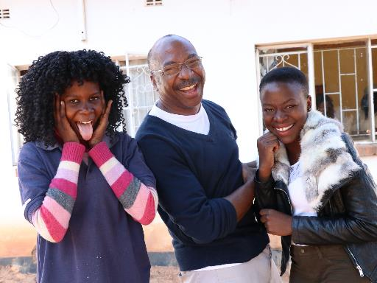
Fulbright is Elite, but not Elitist
4. Fulbright is Elite, but not Elitist
The Bureau of Educational and Cultural Affairs (ECA) of the United States Department of State strives to embed diversity, equity, inclusion, and accessibility (DEIA) in all aspects of its work.
Public diplomacy is most effective when people of diverse backgrounds and perspectives participate in people-to-people exchanges and programs to promote mutual understanding. The Bureau incorporates DEIA best practices throughout its exchanges and programs, grants, community partnerships, and in its workforce and workplace.
ECA is committed to addressing barriers based on race, ethnicity, color, national origin, sex, age, disability, sexual orientation, gender identity or expression, religion, geographic location, education, income, socio-economic status, and other diversity dimensions, that may hinder inclusion in the organization. The Bureau’s commitment to DEIA strengthens U.S. foreign policy and is vital to building trust and partnerships here at home and around the world.

Slide 5
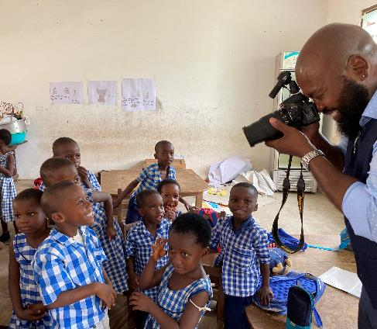
Why Fulbright?
Why Fulbright?
Fulbright is transformational.
Foster relationships that are real and lasting
Expand your publishing network
Become more multicultural in the classroom
Serve as an ambassador for international exchange
Gain the professional recognition as being identified as a “Fulbright Scholar”
Join a vibrant alumni network

Slide 6
Fulbright is family-friendly
Why Fulbright?
Fulbright is family-friendly.
Approximately 60% of our awards provide dependent support
Many Fulbright dependents go on to have international careers

Slide 7
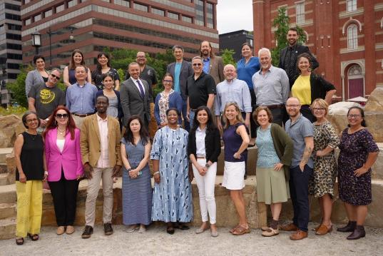
Fulbright is supportive
Why Fulbright?
Fulbright is supportive.
70% of applicants engage with IIE staff
Continued support while in country from IIE and host country staff
Access to Fulbright alumni as a resource

Slide 8
U.S. Scholar Program Eligibility
U.S. citizenship
Degree and experience, as required by award:
Ph.D. or other terminal degree
MA and higher education teaching or professional experience
Professional and/or artistic experience with substantial accomplishments
Teaching experience as required
Eligibility for U.S. Scholar Program
Compliance with policies on previous Fulbright Scholar awards: two year waiting period between Fulbright U.S. Scholar award and next application

Slide 9
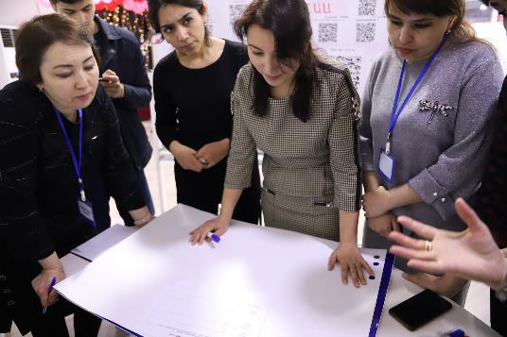
Which Award is for you?
Which Award is for you?
Award Types:
1
Scholar Awards
2
Postdoctoral Awards
3
Distinguished Scholar Awards
4
International Education Administrator Awards

Slide 10
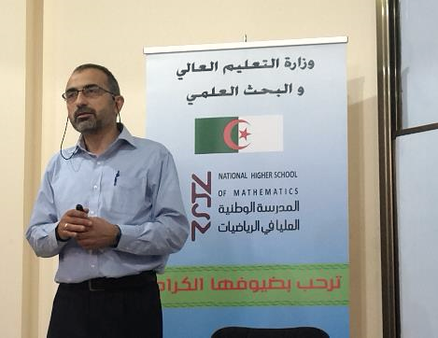
Flex Option
Which Award is for you?
Flex Option
Available in 63 countries and all world areas
Allows multiple visits over two years
Fulbright Public Policy Fellowship
Global & Regional Awards

Slide 11
Selecting the Right Award
Selecting the Right Award
Teaching
Match country interest, expertise, career profile, and proposal to the award description
Language ability (if applicable)
Discipline preferences, when specified
Project relevance to the host country and/or institution
Benefits to you and your community
Research
Teaching/
Research
Professional Project
Remember: you can only apply for ONE AWARD per application cycle

Slide 12
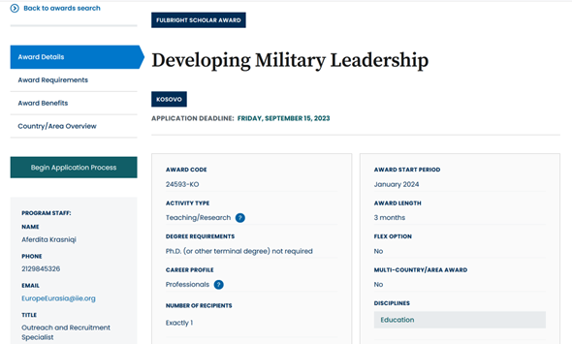
Understanding the Awards
Understanding the Awards
Visit fulbrightscholars.org to search awards
Review important details in:
award details
award requirements
award benefits
country/area overview

Slide 13
Application Components
Application Components
Requirements:
Supplemental Materials:
Application Form
Course outlines or syllabi (for teaching)
Project Statement
Reference list (for research)
Curriculum Vitae or Resume
Portfolio submissions (for artists, architects, and journalists)
2 Letters of Recommendation
Language Proficiency Report (if required)
Letter of Invitation (if required)

Slide 14
Application Cycle
Application Cycle
FEBRUARY
Competition Opens
SEPTEMBER 15
Application Deadline
SEPTEMBER
Program staff conducts technical reviews for completeness
OCTOBER – NOVEMBER
U.S. peer review
Applicants notified of status. Recommended applications are sent to host countries and to the Fulbright Foreign Scholarship Board.
NOVEMBER – JANUARY
JANUARY – JUNE
Final decisions are made
JUNE – ONWARD
Participants prepare for departure

Slide 15
Connect with a Fulbright Alumni Ambassador
Connect with a Fulbright Alumni Ambassador
Official representatives of the Fulbright Program
Share the impact Fulbright had on them personally and professionally, as well as on their institution.
Emeriti Ambassadors
72
New Ambassadors
26
For more information, visit: fulbrightscholars.org/alumni-ambassadors
Events Annually
80+

Slide 16
Bring Foreign Fulbrighters to your Campus
Bring Foreign Fulbrighters to your Campus
FULBRIGHT SCHOLAR-IN-RESIDENCE (S-I-R) PROGRAM
FULBRIGHT OUTREACH LECTURING FUND (OLF)
FULBRIGHT LANGUAGE TEACHING ASSISTANT (FLTA) PROGRAM
STUDENTS
Host scholars from other countries to teach for a semester or an academic year
Deadline: June 1
Website: fulbrightscholars.org/sir
Email: SIR@iie.org
Host current Fulbright Visiting Scholars for short-term lectureships of 2-6 days on discipline or cultural topics to internationalize the campus
Website: fulbrightscholars.org/OLF
Email: OLF@iie.org
Host native speaking language teaching assistants to enhance students’ understanding different languages and cultures
Website:
foreign.fulbrightonline.org
Email: dcook@iie.org

Slide 17
Additional Fulbright U.S. Programs
Additional Fulbright U.S. Programs
SCHOLARS
STUDENTS
TEACHERS
STUDENTS
Fulbright Public Policy Fellowship FPPF@iie.org
Fulbright-Hays Group Projects Abroad Program GPA@ed.gov
Specialist Program FulbrightSpecialist@worldlearning.org
Fulbright-Hays Doctoral Dissertation Research Abroad Program DDRA@ed.gov
English Teaching Assistant (ETA) Program FBstudent@iie.org
Student Program FBstudent@iie.org
Distinguished Award in Teaching Research Program FulbrightDA@irex.org
Group Projects Abroad GPA@ed.gov
Teachers for Global Classrooms FulbrightTGC@irex.org

Slide 18
Stay Connected
Stay Connected with Fulbright
EMAIL us at scholars@iie.org
VISIT fulbrightscholars.org to learn more about the Fulbright U.S. Scholar Program
REFER your colleagues

