Slide 1
Placing your Book in the Rapidly Changing Academic Publishing Landscape
Dylan Mohr
Open Scholarship Librarian Syracuse University Libraries

Slide 2
Outline for Today’s Session
Today’s session will discuss the following:
Changes to the publishing industry that have motivated the open access movement
The different forms of open access publishing
How open monographs are different that open journals
Reasons to consider making your book open access
Questions to ask your publisher before choosing to make your work open access

Slide 3
Changes to the Publishing Landscape
Journal Title | Cost in 1983 | Cost if Based on True Inflation ^{[2]} | Cost Today
Nature | $220 | $354.11 | $40,292.31
Science | $85 | $136.82 | $25,884.06
New England Journal of Medicine | $48 | $77.26 | $18,890.00

Slide 4
The Rise of Open Access

Slide 5
APCs and BPCs
Article processing charges are fees charged by publishers to authors that make their work open access
These fees range from a couple hundred dollars to thousands of dollars
Cell: $9,900 (hybrid, Elsevier)
Austrian History Yearbook: $3,250 (hybrid, Cambridge)

Slide 6
Types of Open Access
Gold Open Access
Green Open Access
Diamond Open Access

Slide 7
Gold Open Access
Gold Open Access
Gold OA with APC
Author pays
Gold OA without APC
Free for author (sometimes called diamond OA)
Transformative agreement (read and publish)
Free for author (library pays APC)

Slide 8
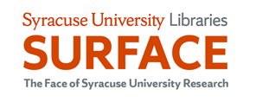
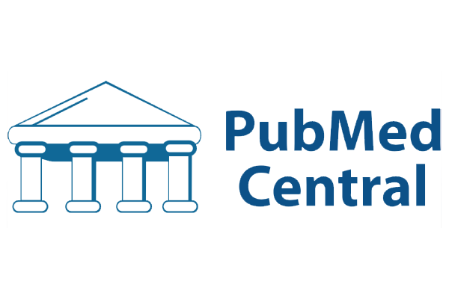
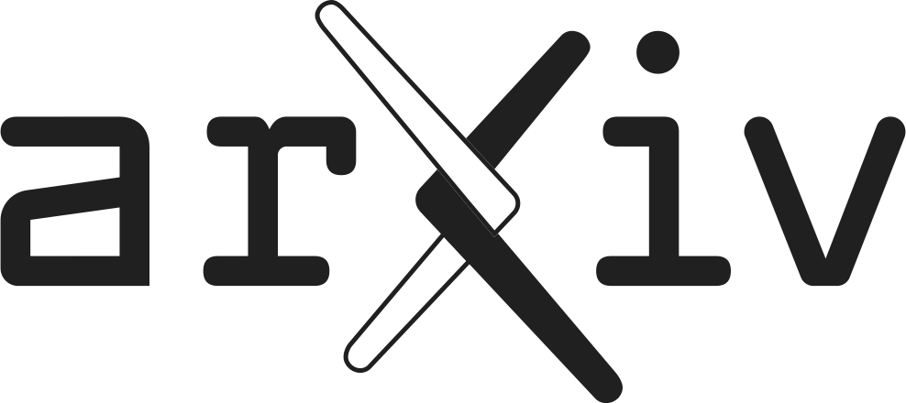
Green Open Access
Sometimes called “self-archiving,” refers to pre/post print articles deposited by authors in a repository like SURFACE or arXiv.org.
Green OA is always free, though there may be restrictions.
If you’re an author, consult Sherpa Romeo to see how your publisher will let you share.

Slide 9
Why Consider Open Access?
Equity
Scope and reach
Audience
Citations and downloads
Precarity of scholars isn’t going anywhere…

Slide 10
Statistics and Usage Data (Springer)
OA books got 10x more downloads
More diverse readership
Books downloaded in 61% more countries
Books with names of country in titles saw greater use in those countries

Slide 11
Scope and Reach
University of Michigan Press study of 1,500 OA titles
85% of non-institutional use coming from outside of the US
Turkey and India huge consumers
Cataloging and acquisition matters (libraries that ingested titles saw the greatest use)
Monographs are read!
Massive download numbers reflect this
Policy makers have been large consumers

Slide 12
Unexpected Readership and Results
UMich Press also sent out surveys to those who downloaded OA books. 700 responded. Briefly:
Educated lay person exists!
Policy makers find OA monographs
So far, no decrease in print books sales

Slide 13
Experiences
Dragostinova, Theodora. The Cold War from the Margins: A Small Socialist State on the Global Cultural Scene. Cornell University Press, 2021.
Why open access?
I mainly wanted to make the book available in eastern Europe, but also wanted to expand my readership, as I published OA + paperback.
Did Cornell do promotional work for your book? Was there any difference between The Cold War from the Margins and Between two Motherlands in this regard?
Same promotional policies, but one does need to make sure they send hard copies to journals for reviews.
Have you seen any difference in usage between your previous, non-OA books and The Cold War from the Margins?
I do believe more people are reading this book, but it is somewhat anecdotal; I don’t have data on sales, which I probably should get. I do know there are 1000+ download on the Cornell press website, but there are various other repositories, so getting these figures is complicated.
Do you have any regrets?
No regrets. I got a cheap paperback ($19.95) and 40 photos, something I would not have without OA.

Slide 14
28 color illustrations
and a great cover!
University of California Press

Slide 15
From Publishers (MIT, Duke, Michigan)
Hesitations
Money - According to our surveys, over 50% of authors either don't have the money to spend to turn a book open and/or don't think they should have to be the ones to pay for it.
Quality - Another large group expressed concerns about the quality of open access publishers
Perception - This is sometimes related to the question of quality, but some scholars are concerned about how publishing OA will be perceived by their peers. Is it something that will hurt their future opportunities?
Points of Enthusiasm
Nearly authors expressed that their biggest reasons for publishing OA revolved around equity, inclusion, and access to knowledge
Others wanted to reach a larger, more international audience
And others see it as a way to boost citations

Slide 16
Open Access Support
Publishers without BPCs
MIT (Direct to Open)
University of Michigan (Fund to Mission)
Many publishers offer BPC waivers
University of California Press (Luminos)
Radical Open Access’ Funding Opportunities
https://radicaloa.disruptivemedia.org.uk/resources/funding-opportunities/

Slide 17
Leading OA Monograph Publishers
Most academic publishers now offer open access options:
Duke
University of California
MIT
University of Michigan
University of Minnesota
Cambridge
University of Toronto
Berghahn
Cornell
University of Amsterdam
Central European University

Slide 18
Questions to ask your Publisher
How do you promote getting your OA content indexed in libraries?
What opportunities does publishing open provide? Have you seen increases in usage or citation for open access titles?
Will there be a print version as well?
Do you send print copies to journals for review?
If you have questions, ask questions!

Slide 19
Thank You!
Dylan Mohr
Open Scholarship Librarian
dpmohr@syr.edu

