Slide 1

How to Apply for the 2022 CUSE Grants Initiative https://syracuse.infoready4.com/
Office of Research
Notes:
This video will walk through the application steps for the 2022 Collaboration for Unprecedented Success and Excellence (CUSE) Grant Program. We will begin with the application web site. Select the link here to begin your application. syracuse.infoready4.com/

Slide 2
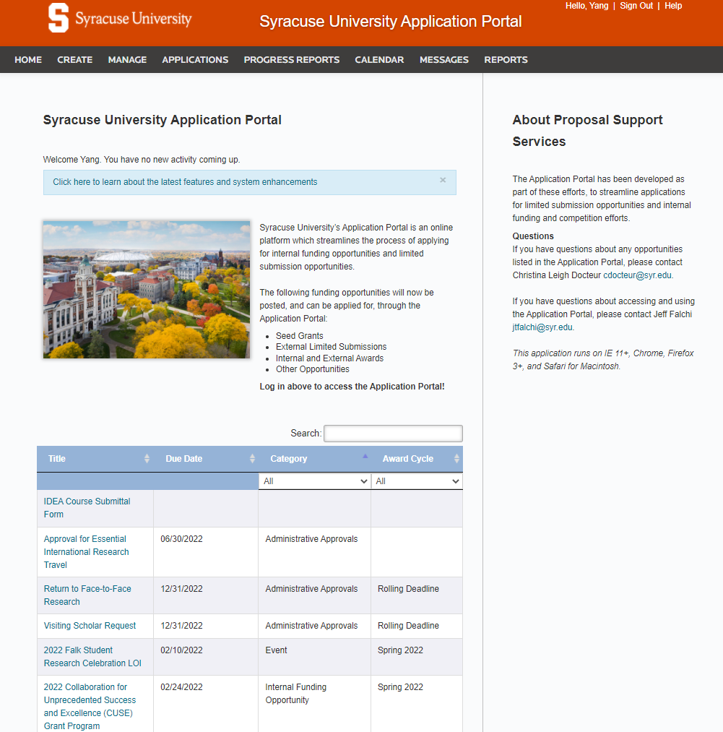
Application Portal Home Page
Notes:
This will take you to the Syracuse University Application Portal.

Slide 3
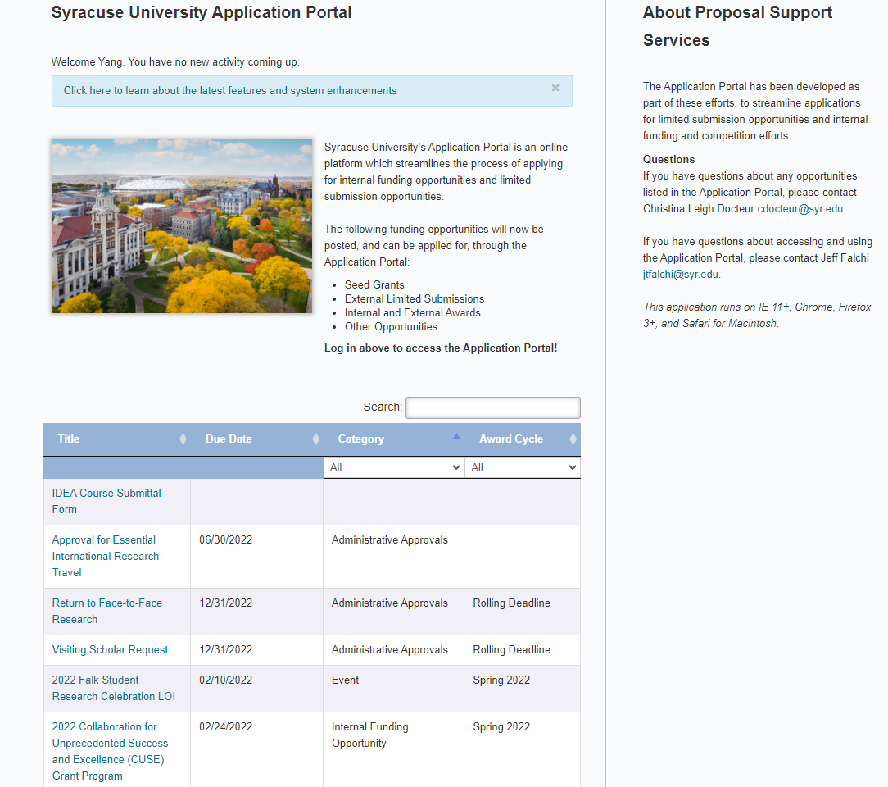
Application Portal Home Page 2
Notes:
The application will appear here. Select the 2022 CUSE Grant Program to apply.

Slide 4
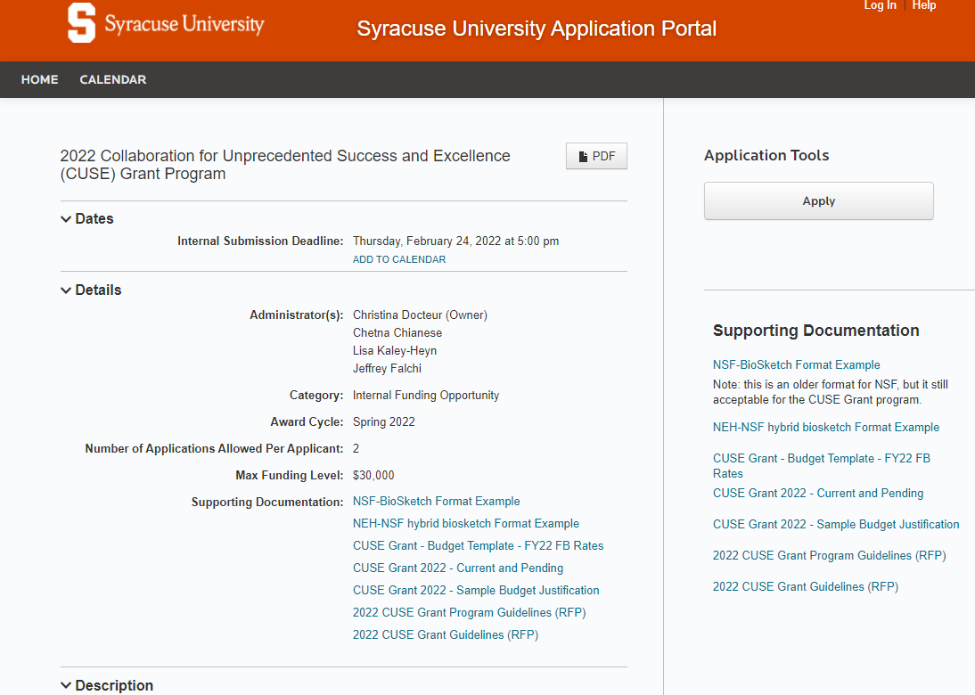
Application Portal – CUSE Grants Page
Notes:
This will take you to the Details Page of the CUSE Grant Application. Before we move on, we would like to point out a few important items on this page. At the top, please note the submission deadline is Thursday, February 24, 2022 at 5:00PM Eastern Time. The application system will automatically close at that time, so be sure to get your applications submitted before the deadline.

Slide 5
Application Portal – CUSE Grants Page - 2
Notes:
You will select Apply on the right side to access your online application.

Slide 6
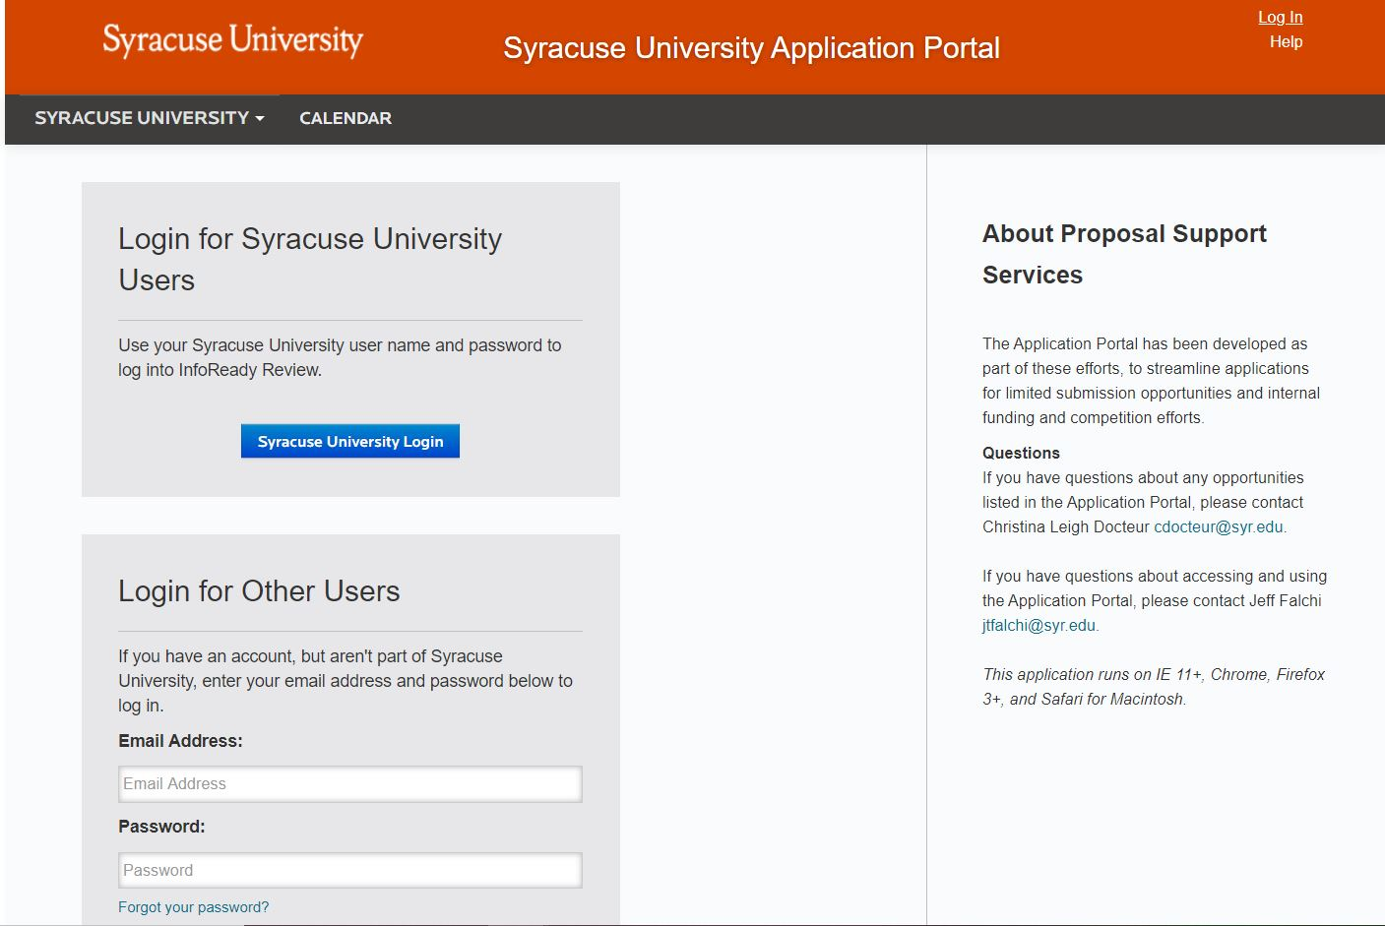
Application Portal Login Page
Notes:
Click Syracuse University Login

Slide 7
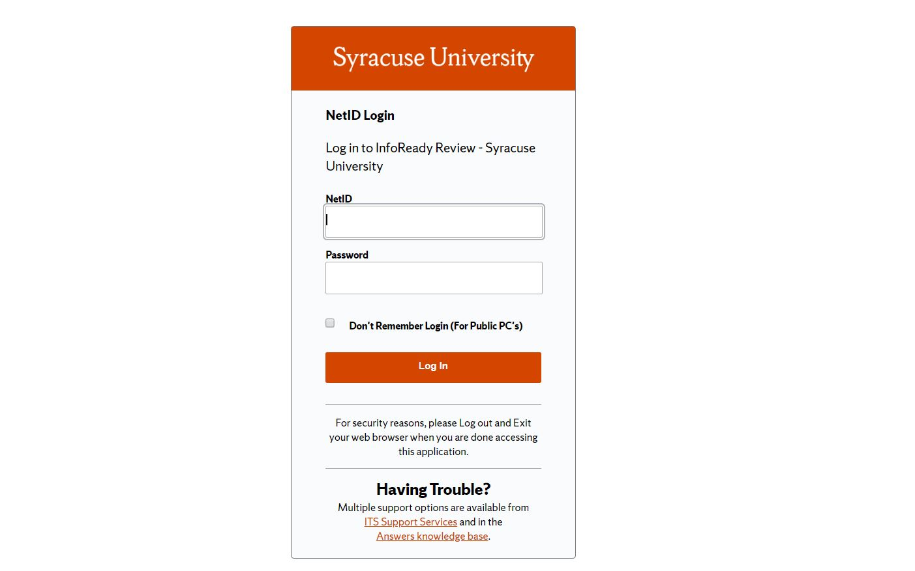
SU Login Page
Notes:
Login with your NetID and password to access the application.

Slide 8
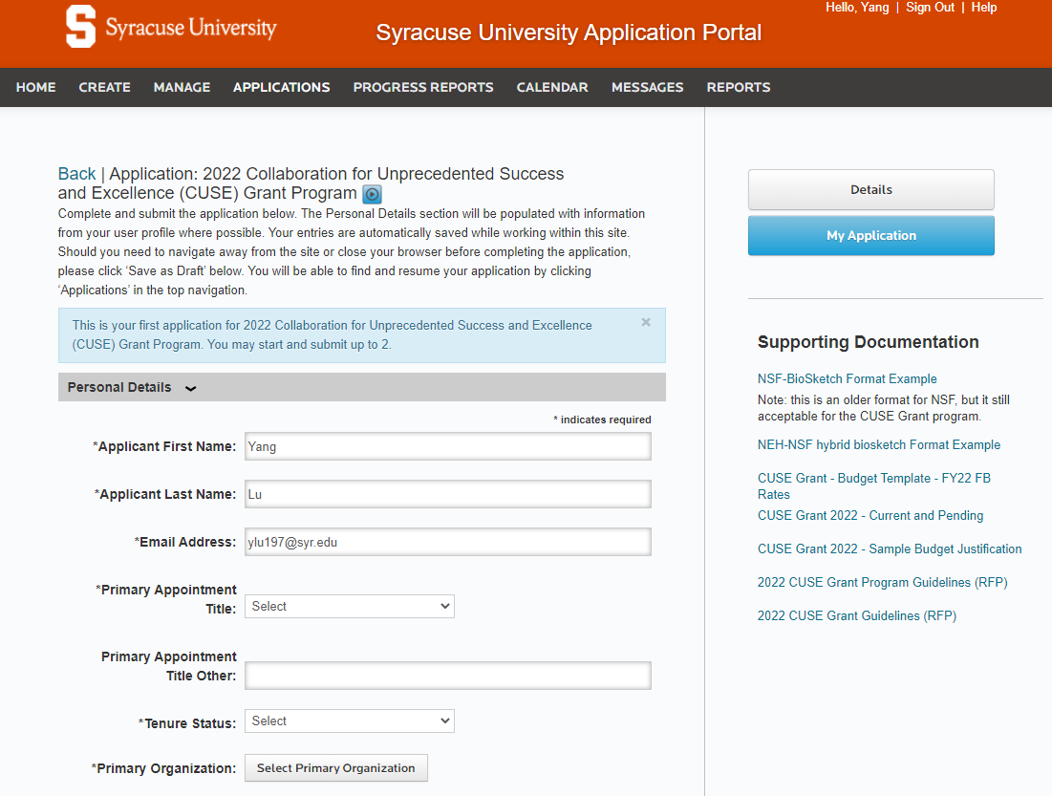
CUSE Grants Application Page
Notes:
This is the application. You will begin by filling out the personal Details section which includes the PI’s basic information. Your first name, last name, and email address may have automatically been added after signing in with your SU NetID

Slide 9
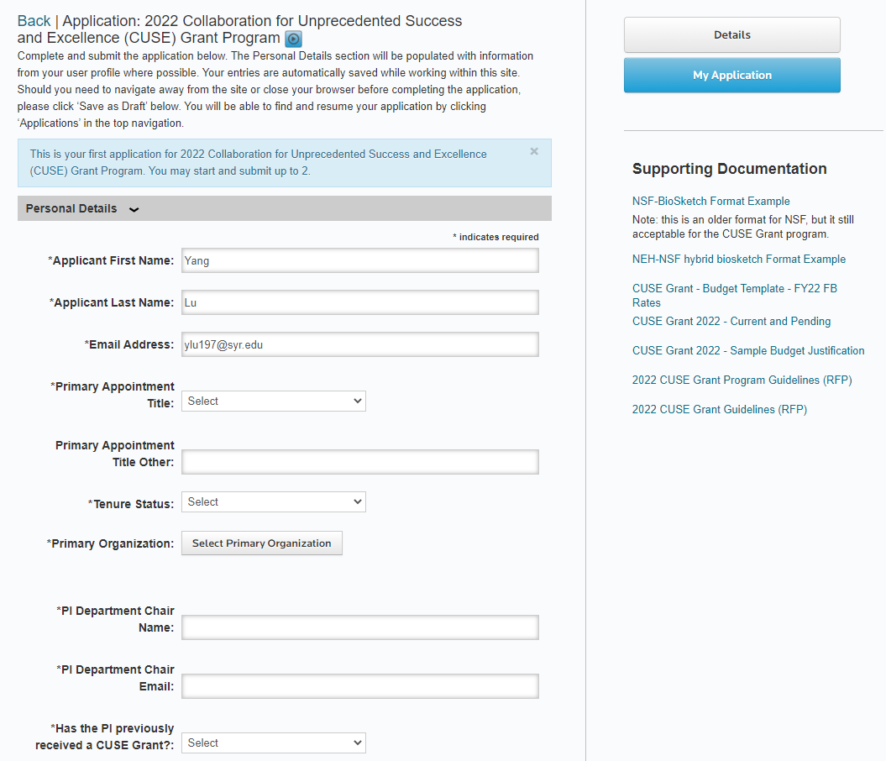
CUSE Grants Application Page - 2
Notes:
Along the righthand side, you will see the Competition Files. These are required forms and optional examples to use for your application.

Slide 10
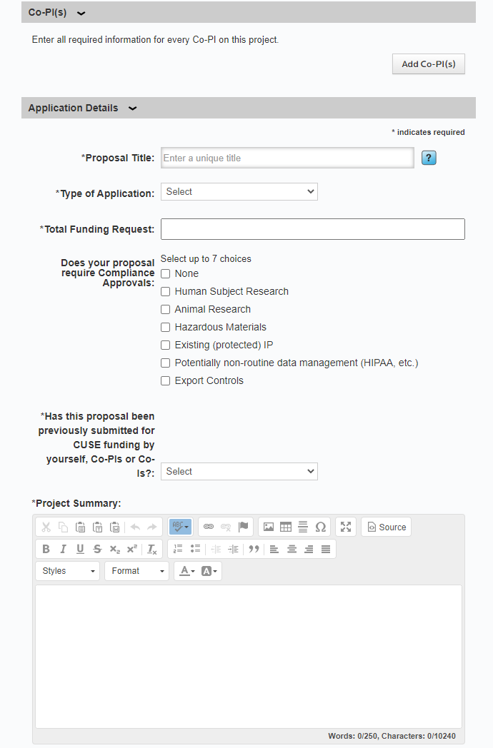
CUSE Grants Application Page - 3
Notes:
Next you will need to complete all of the textbox responses including, identifying all Co-PIs by Name, Role, email, Department, and School or College.

Slide 11
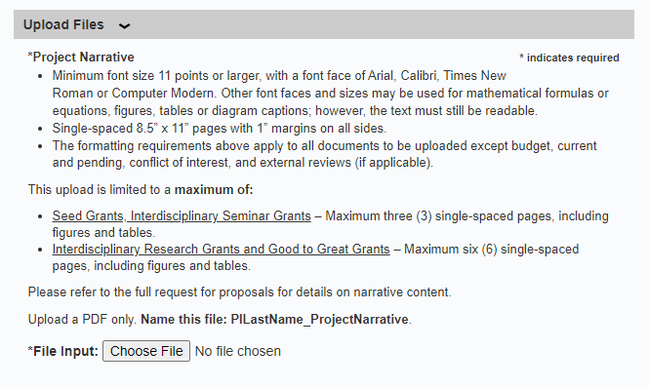
CUSE Grants Application Page – Uploads – Project Narrative
Notes:
As we continue, you will see the Uploads Section. The first upload will be a project narrative. Formatting guidelines are provided here in the application portal, as well as in the full request for proposals. A link is provided to the RFP details.

Slide 12
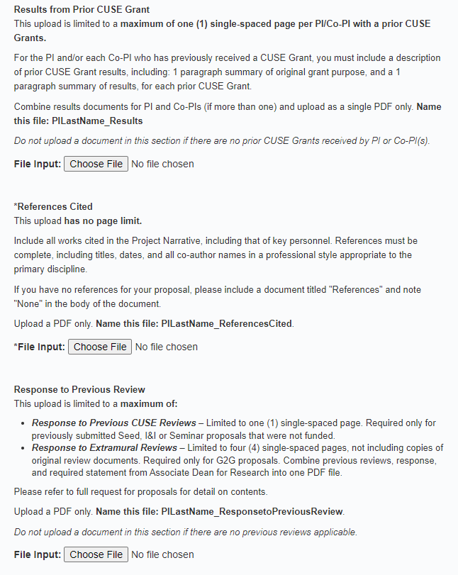
CUSE Grants Application Page – Uploads – Other Uploads
Notes:
Other necessary documents will include, a statement on the results of any prior CUSE grants and a list of references cited

Slide 13
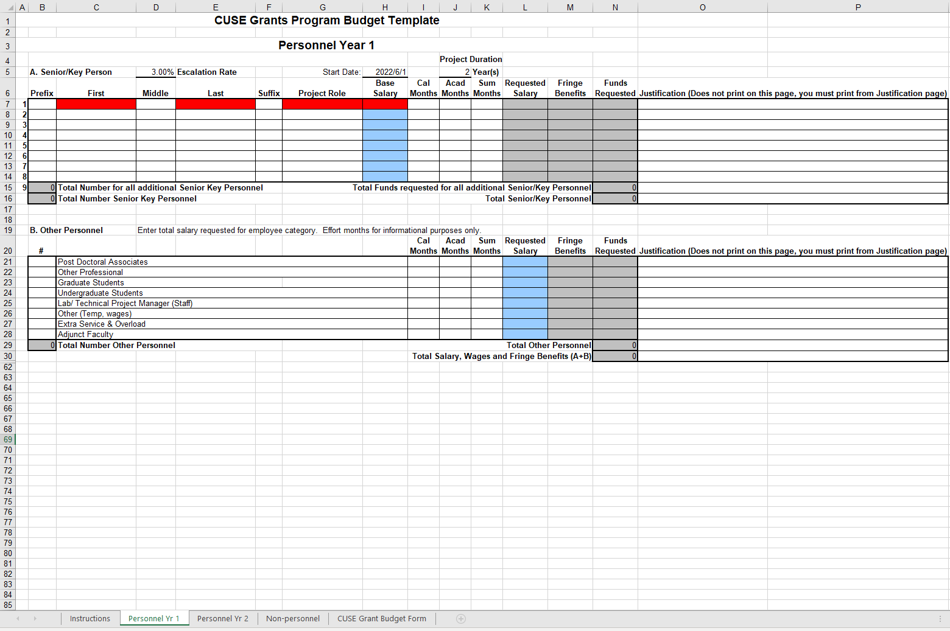
CUSE Grants Application Page – Uploads – Budget Form
Notes:
As you scroll down, you will notice that the application requires you to fill out and upload the budget request form. This form can be found in the system under Competition Files. You will need to check with your Department/college for any internal requirements or deadlines to have this prepared in time. You will also need to upload a corresponding budget justification.

Slide 14
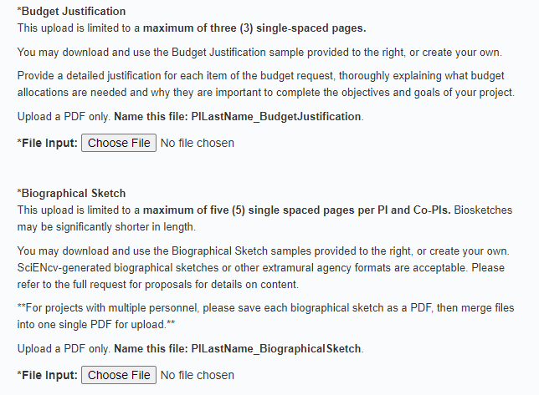
CUSE Grants Application Page – Uploads – Budget Justification and Biosketch
Notes:
Next you will need to upload your biographical sketch.

Slide 15
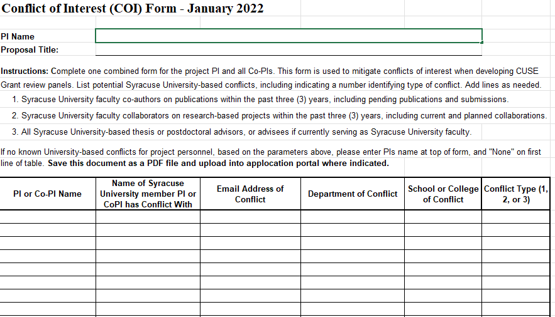
CUSE Grants Application Page – Uploads – COI Form
Notes:
You are also required to fill out the Conflict of interest form. This form can also be found in the system under Competition Files. Complete one form for the entire project. listing all potential Syracuse University-based conflicts for the PI and any Co-PIs. If there are no University-based conflicts identified, based on parameters described in template, please enter the name of the PI on the top of the template, and indicate "None" in the first line of the table.

Slide 16
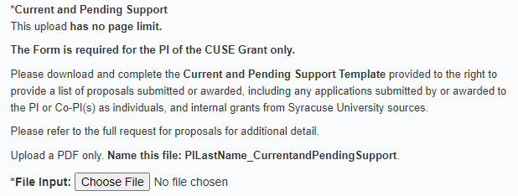
CUSE Grants Application Page – Uploads – Current and Pending
Notes:
The PI will also need to download and submit the document for “Current and Pending Support”.

Slide 17
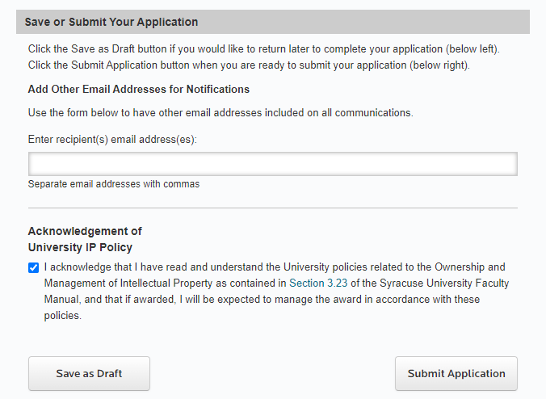
CUSE Grants Application Page – Submitting Your Application
Notes:
Lastly, you will find the save or submit section of your grant application

Slide 18
CUSE Grants Application Page – Submitting Your Application 2
Notes:
You may at any point save your application as a draft, to be continued and submitted before the deadline.

Slide 19
CUSE Grants Application Page – Submitting Your Application 3
Notes:
Please remember to read through the CUSE guidelines carefully. They contain all of the requirements for completing each section of the application. When you are ready, click “submit application” in the lower righthand side of the screen.

Slide 20
Some Helpful Hints
If you decide to delete an item after you have uploaded it, click on the red delete button in small print next to the item.
Please pay attention to page limits. Applications will be reviewed for compliance and reviewers will be instructed to ignore information on pages beyond the limit.

Slide 21
Reminders
Applications must be submitted by 5:00pm, February 24, 2022
Early submissions are strongly encouraged!
An email acknowledgment of receipt will be sent once the CUSE grant application is received

Slide 22
Thank You
Christina Leigh Docteur
Director, Proposal Support Services
cdocteur@syr.edu
Phone x2195
Stuart Taub
Director, Sponsored Programs
staub@syr.edu
Phone: x9356
Notes:
Finally if you have any questions about your CUSE grant application, please do not hesitate to contact any of the contacts listed here. Thank you

