Slide 1
Introduction to Research Development in Humanities & Creative Arts
Sarah Workman, Assistant Director, Research Development (Humanities)
Office of Research | College of Arts and Sciences
srworkma@syr.edu
Notes:
What structures of support exist at SU – what resources exist
Why apply for funding (grants and fellowships; internal and external)
What do I do, institutionally and with Creative Arts faculty

Slide 2
What brings you here?
What brought you to the VPA Research and Creative Activities working group?
What questions do you have before we get started?

Slide 3
Agenda
Introduction / About Me
Why apply for funding opportunities?
Relevant resources at SU
Identifying funding opportunities (internal & external)
PIVOT
Q & A

Slide 4
About Me / About Humanities Research Development
Sarah Workman is Assistant Director for Research Development (Humanities), a position split between the College of Arts & Sciences and the Office of Research in order to elevate research achievement and recognition for campus-wide humanities scholarship. From my two homes on campus, I provide support for research development at any stage of the process, including helping humanities faculty identify funding sources, assisting with grant and proposal writing, and coordinating nominations for honorary awards.
Humanities Research Development
Notes:
Position was new as of June 2019; PSS wasn’t even PSS until Christina Leigh Docteur, Director, was hired in March 2018
HC is third home on campus

Slide 5
About Me / About Humanities Research Support
Examples of support for VPA faculty:
Funding Search
Brainstorming session
Breaking down RFP (can I apply? Am I eligible? What do they want?)
Proposal review and feedback (multiple rounds)
Budget analysis – how to spend the $$, what’s allowed, what’s not
Facilitating connections with campus partners
Review and repurposing of unfunded project
CUSE grant strategy session
Notes:
Worked with 23 VPA faculty to date, and this is what I’ve done
Campus partnerships refers to: Connecting you with institutional support from Corporate and Foundation Relations; Office of Sponsored Programs; SU Librarie
Connecting you with SU’s membership in the National Center for Faculty Diversity and Development
Could also do: book proposal development

Slide 6
Why Apply?
Enhances research, scholarship, & creative work
Broadens your networks, builds connections
Contributes to your tenure & promotion portfolio
Helps define ideas for your writing and creative work
Provides opportunities for mentoring and collaboration
Successful awards pave the way for other opportunities
Notes:
Important to start with the why because supporting applications in this space is a priority especially for my CAS hal
Enhances research & scholarship:
buys you time for you to do your work;
Broadens your networks, builds connections: Yaddo, MacDowell
Contributes to your tenure & promotion portfolio
Helps define ideas for your writing and creative projects
Firm believer in “writing as thinking”; The process of writing in the genre of the research proposal helps you articulate your ideas; mutually illuminates the actual research itself, and I’ve had many faculty members express this to me during the process of revision and toggling back and forth between a proposal and their journal article or book manuscript
Provides opportunities for mentoring and collaboration
True as applicant (seeking mentorship) and recipient (mentor)
Small successes pave the way for other opportunities
Do not discount smaller opportunities (library fellowship or smaller grant that could be tied to a local/regional opportunities, like Humanities New York, or the CNY Humanities Corridor) as those building blocks to larger fellowships

Slide 7
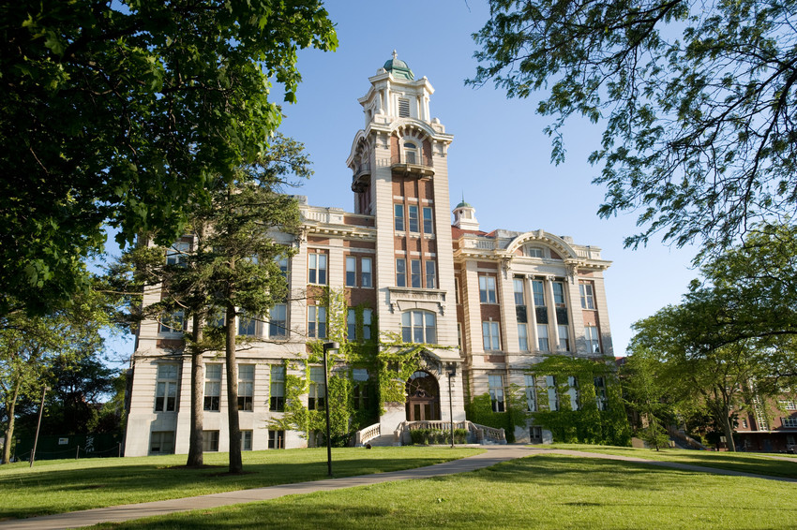
Office of Proposal Support Services

Slide 8
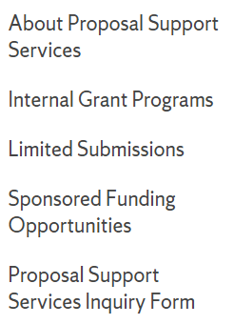
Who is the Office of Proposal Support Services?
Christina Leigh Docteur, Director
Chetna Chianese, Associate Director
Sarah Workman, Assistant Director
Jeffrey Falchi, Research Information Mngr
Location
226 Lyman Hall
Contact
cdocteur@syr.edu 315-443-2195
cchianes@syr.edu 315-443-2084
srworkma@syr.edu 315-443-5260
jtfalchi@syr.edu 315-443-6627
Website
https://research.syr.edu/proposal-support-services/
Notes:
Four units in Office of Research:
PSS: Research development
Office of Sponsored Programs: assists faculty, staff and students in the preparation and submission of research proposals and the management of externally funded research and scholarly projects
ORIP (Office of Research Integrity and Protections, Tracy Cromp): Human subjects research, animal subjects research
Office of Technology Transfer (Jennifer Crips) University-owned intellectual property arising from the research and scholarly activity of the University community.

Slide 9
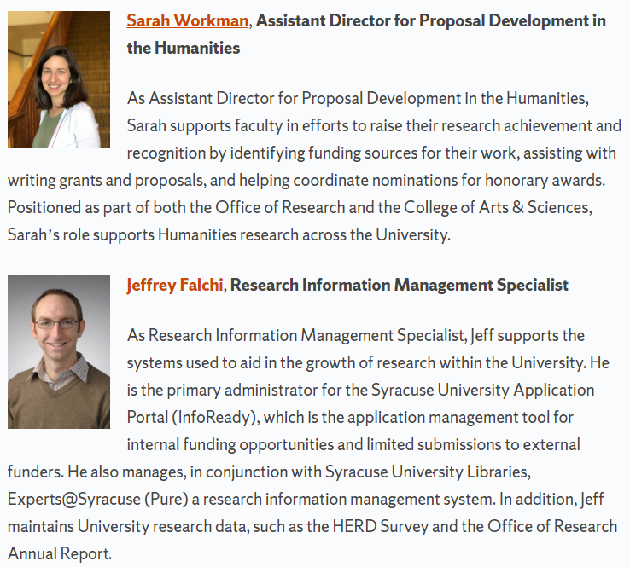
Relevant resources at SU
Office of Research
Proposal Support Services

Slide 10
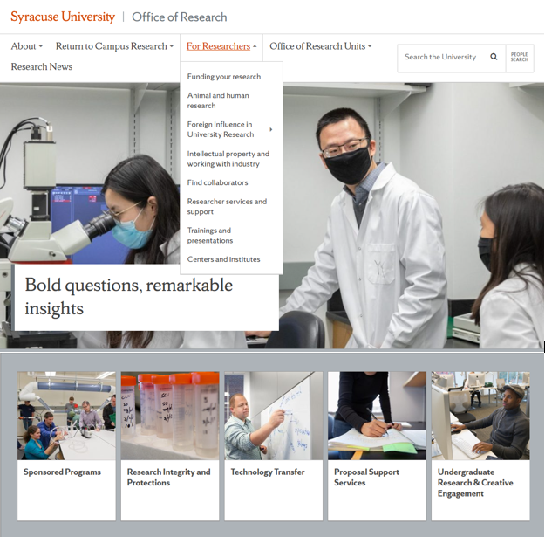
What Does Proposal Support Services Do?
One of the five subunits of the Office of Research https://research.syr.edu
“Research development”
Institution-wide internal grant programs “CUSE Grants”
Limited submission and award nomination management
Funding opportunity circulation and grant development for large and/or multidisciplinary projects
Hub of the “SURD Team”
Notes:
National Endowment for the Arts Grants for Arts Projects: February 11 & July 8

Slide 11
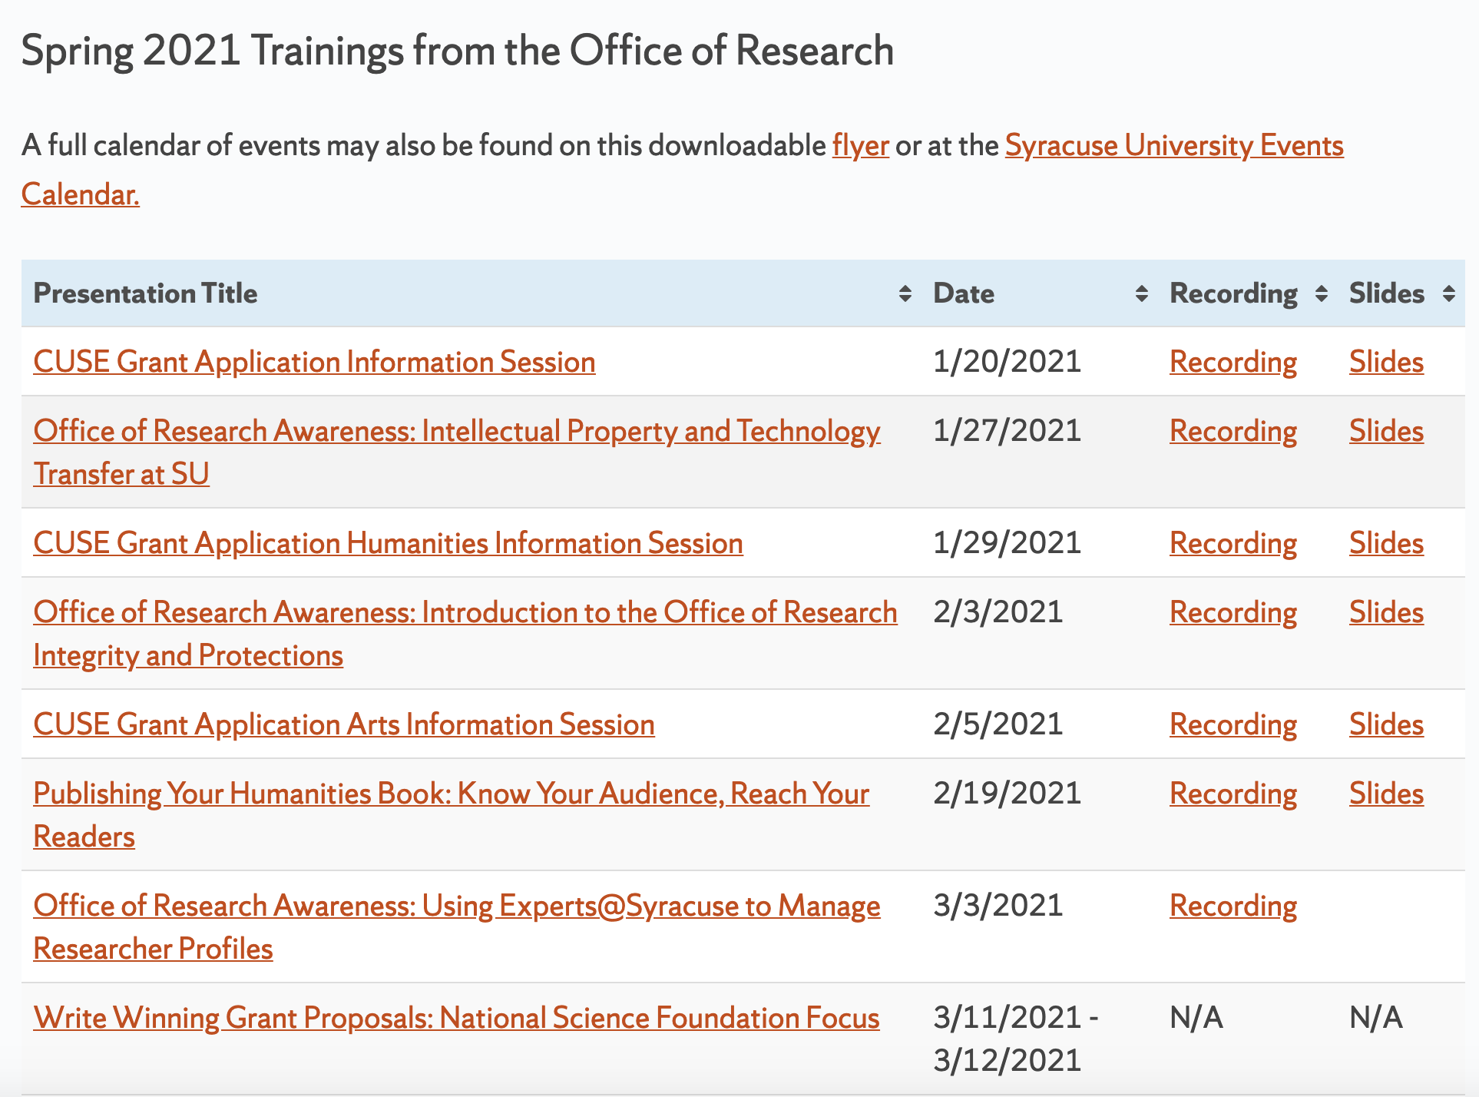
Proposal Support Services: Trainings and Presentations
PSS Trainings and Presentations are available on the Office of Research website under Proposal Support Services.
Notes:
Chetna

Slide 12
Campus Partners

Slide 13
Institutional Partners
Office of Corporate & Foundation Relations – Gary Girzadas (gsgirzad@syr.edu), Executive Director; Nora Heaphy (nheaphy@syr.edu) Director, Foundation Relations
SU Libraries – Emily Hart (ekhart@syr.edu), Science Librarian, Research Impact Lead
Office of Sponsored Programs (unit of the Office of Research) - Research administrators from OSP are assigned to individual schools and colleges

Slide 14
Syracuse University Humanities Center
Vivian May, Director | PI, CNY Humanities Corridor | Professor, Women’s & Gender Studies
SUHC facilitates partnerships and supports diverse research activities across SU and throughout the region. Their initiatives include:
Fellowships for faculty and graduate students;
Funding for humanities collaborations via the CNY Humanities Corridor, an 11-institution regional consortium housed at the Center;
Syracuse Symposium, their thematic annual public events series;
Programming partnerships / co-sponsorship funding;
Annual Books in the Humanities recognition, open to all SU authors.
Notes:
Current theme: Conventions; Erin O'Hara (Composer)
Society for New Music and the College of Visual and Performing Arts welcomes composer Erin O’Hara, who combines feminist storytelling with punk music to bring the convention-breaking character “Lulu” to life in a re-scoring of the classic silent film, Pandora’s Box.
Pixy Lao (photographer) coming in February
Next Year: Repair
Working group grants support:
Honoraria
Scholars, artists, experts, workshop or retreat facilitators, and authors (all from non-Corridor institutions) can be paid honoraria with our funds.
Individuals from Corridor institutions cannot receive honoraria from our funds.
Campus IT Support
Books, E-Books, or Supplies
Consultant or Vendor Fees
Catering and Meals (in accordance with the host campus’s public health guidelines)
Accessibility Funding*
To support accessibility and inclusive format activities, complete the Accessibility Funding section on the proposal form. For online activities, this could include real-time captioning and transcription.
Travel Costs (in accordance with the host campus’s public health guidelines)
Intra-Corridor Travel Supplement* reimbursements help convene WG members from across Corridor campuses and help faculty/academic staff/graduate students attend Corridor activities (symposia, workshops, etc.) at other Corridor institutions.
*Note: Accessibility Funding and the Intra-Corridor Travel Supplement are both available, above and beyond amounts proposed/awarded via your Working Group Activity Budget(s).

Slide 15
Identifying Resources

Slide 16
Before you look. . .
What do you want to do?
What do you need?
Time? Project support? Student support?
Are you geographically mobile?
What is your ideal timeline?
For fellowship support, do you have an upcoming leave?
Notes:
What do you want to do?
What do you need?
Are you geographically mobile?
There are more RESIDENTIAL than NON-RESIDENTIAL fellowships
How long do you want to be away?
What is your ideal timing for your fellowship?
No set timeline for applications; really depends. I can say that there’s usually a series of deadlines in early fall and another in mid-spring, but there are always going to be deadlines that are off-cycle, or even those that have two deadlines per year, American Philosophical Society Research grant ($6K)
Do you have an upcoming leave?
Big incentive to apply is that the fellowship could allow you to be away for longer than a semester with more support; CAS currently developing a policy in line with peer institutions on this, but there is precedent in both Maxwell and CAS for prestigious fellowships allowing faculty to take a year leave
Your chair should know the appropriate steps in your school/college for applying for leave; usually 1-year out

Slide 17
Resources for Identifying Funding Opportunities (Internal)
Internal Funding Opportunities
Under SU Humanities Center Research Support: On-campus fellowships and Faculty and Staff Funding for Humanists
Collaboration for Unprecedented Success and Excellence Grants (CUSE)
Internal/External Support
CNY Humanities Corridor Working Groups

Slide 18
Collaboration for Unprecedented Success and Excellence Grants (CUSE)
Talk with 2021 recipients for advice
Title | Participant | Role | School/College/Unit | Department | Program Type
Kairos: The Artifact | Hanlin, Heath | PI | VPA | Transmedia | COVID-Relief Grant
Military and Veteran Family and Caregiver Virtual Art Therapy and Community Arts Engagement Pilot Program | Miller, Thomas | PI | VPA | Drama | Innovative & Interdisciplinary Research Grant
The Infernal Grove: an immersive video installation | Duke, Emily | PI | VPA | Transmedia | Innovative & Interdisciplinary Research Grant
Along These Waters, Lost Voices of the Erie Canal | Page, Meri | PI | VPA | School of Design | Seed Grant
CHIMERA: Art and Science Exhibition Programming | Dragoeva, Boryana | PI | VPA | Transmedia | Seed Grant
Gen Z appropriating media in everyday conversations before and after COVID-19 | Sierra, Sylvia | PI | VPA | Communication & Rhetorical Studies | Seed Grant
New Works, New Voices Initiative | Wrinn, Kathleen | PI | VPA | Drama | Seed Grant

Slide 19
Resources for Identifying Funding Opportunities (External)
External Opportunities
Sign up for / check out:
Office of Research Curated Funding Lists
PIVOT: an easy-to-use key-word-searchable database for finding current funding opportunities specifically tailored to research needs
OoR Presentation & Training: PIVOT
Biannual email from srworkma@syr.edu
KU The Hall Center for Humanities lists
Professional listservs/networks
Colleagues/mentors
Foundation Directory Online
Philanthropy News Digest by Candid → RFPs → Arts/Culture → Register
Artist Archive → Sign up
“Best Opportunities for Artists in November”
NEA Newsletter sign-up
NYFA Opportunities
Notes:
Curated Funding Lists: The searches will initially display with new opportunities from the past week. By selecting “All” in the search window, you will find opportunities added in the last 30 days. Pivot login required
Have to play the long game with PIVOT; set up a saved search and forget; can toggle for international scholars or those who are NOT US citizens, I know this can be a concern
Hall Center: has individual, institutional, and creative works
Professional listservs/networks are great for the smaller “boutique” fellowships; a faculty member in AMH just sent me a seed grant for ethnomusicologists research music and minorities that she learned about through her professional listserv; The big fellowships (NEH, Radcliffe, Guggenheim, etc.) are the ones everyone knows about, and since virtually anyone can apply for them, they are extremely competitive. Try to find fellowships that might be less well known or specific to your field or topic of research—Here I’m thinking of 4Cs: The Conference on College Composition & Communication offers an early career research award for $10K. Reach out to your networks for this information (ask your colleagues for suggestions).
INTERNAL:
Collaboration for Unprecedented Success and Excellence

Slide 20
Key Funders (External)
External Opportunities
Residencies
New York State Council on the Arts (NYSCA)
New York State Foundation on the Arts (NYFA)
National Endowment for the Arts (NEA)
Grants for Arts Projects Limited Submission Competition ($10,000 - $50,000)
Create a PIVOT search
Resartis.org (international)
Notes:
MacDowell

Slide 21
PIVOT

Slide 22
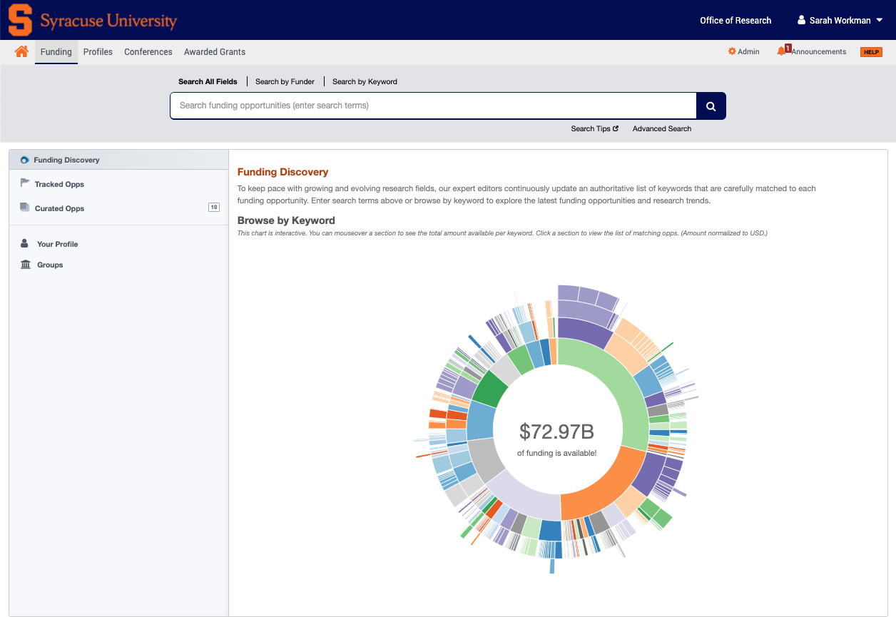
Navigating PIVOT
What is Pivot?
https://pivot.proquest.com/
Pivot is a database containing active funding opportunities for all disciplines and project types.
It includes a wide variety of funding types, including federal U.S. government, private foundations, and corporate and international funding opportunities.
Notes:
Chetna

Slide 23
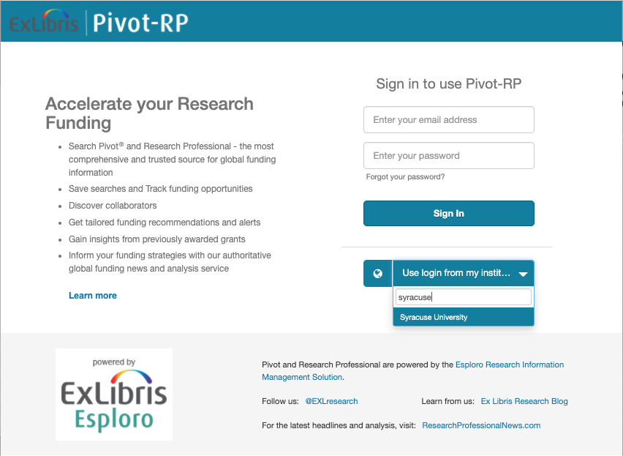
Navigating PIVOT: Signing In
Pivot
Signing in with Shibboleth
Navigate to page
Select institution
Login with SUID & PW
Finalize your account
Notes:
Chetna

Slide 24
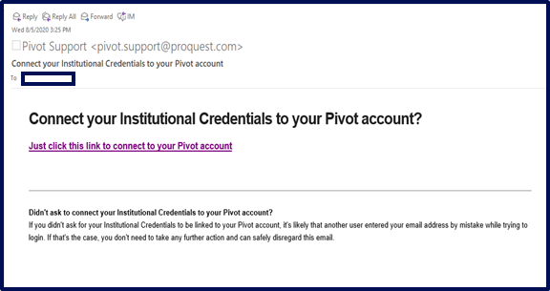
Navigating PIVOT: Existing Users
Existing Pivot Users
Sign in
Connect your institutional credentials to your existing account
Note: Anyone with an syr.edu
email is eligible for a Pivot account.
If you leave SU for another institution with a subscription, your account can be affiliated with your new institution.
Notes:
Chetna

Slide 25
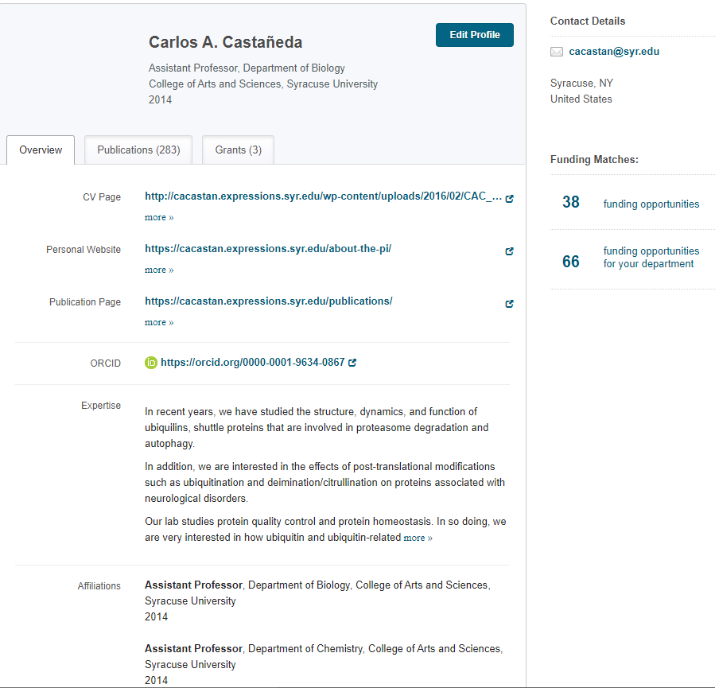
Navigating PIVOT: Claiming/Creating Your Profile
If it is your first time logging in, select “Claim Profile” in the user menu
Create your profile following the on-screen steps
Notes:
Profiles: From Home Page, Select “My Profile” ; Click link on top right to edit
Add in Keywords so that Pivot’s Advisor can suggest funding opps
Add in your ORCID to automatically pull in your publications
Or manually add in your publications, grants, and patents
Pivot will match funding opportunities based on your keywords and profile and send you weekly emails

Slide 26
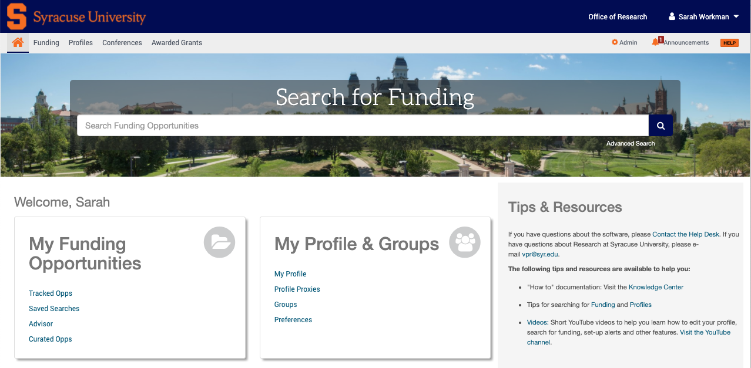
Navigating PIVOT: Conducting a Funding Search
Notes:
Christina – CHANGE SLIDE PICTURE AND ARROWS

Slide 27
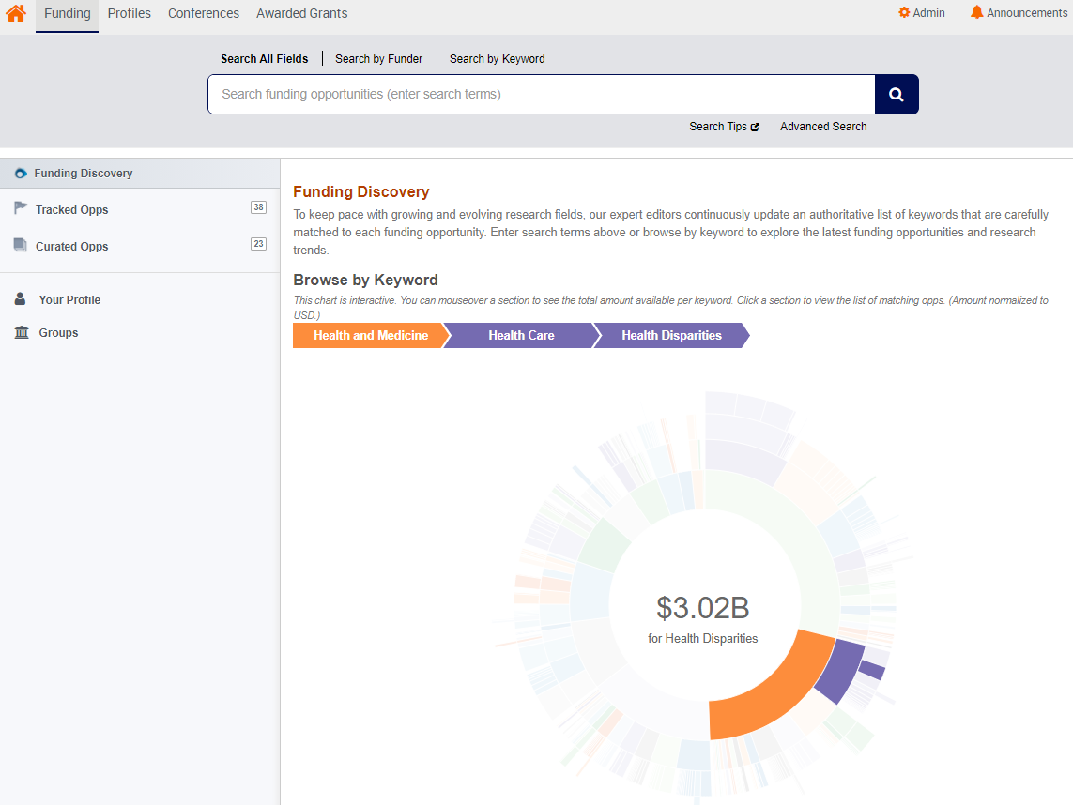
Browsing by Keyword
Utilize the interactive Pivot wheel chart on the main funding page to browse by field or subfield
Browse to see what subfields are receiving the most funding
Also shows how subcategories of funding are organized in Pivots keywords
Notes:
Christina

Slide 28
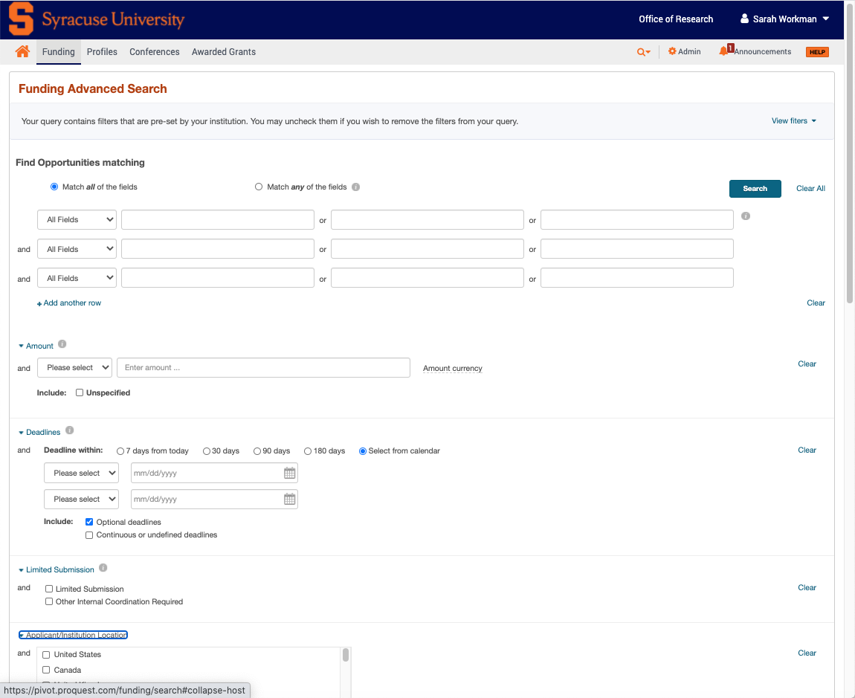
Advanced Search
Amount
Deadlines
Limited Submission
Applicant/Institution Location (preset)
Activity Location
Citizenship*
Funding Type*
Keyword*
Applicant Type*
Funder Type
Country of Funder
Recently Added
Exclude Opportunities matching
Notes:
Christina

Slide 29
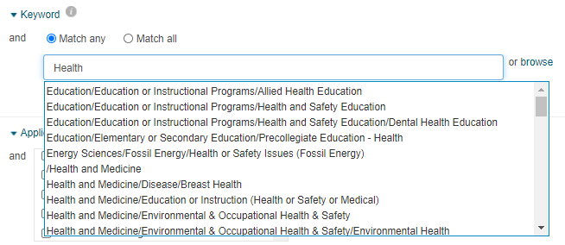
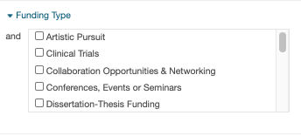
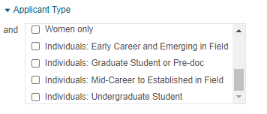
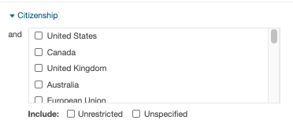
Advanced Search “Musts”
Notes:
Christina

Slide 30
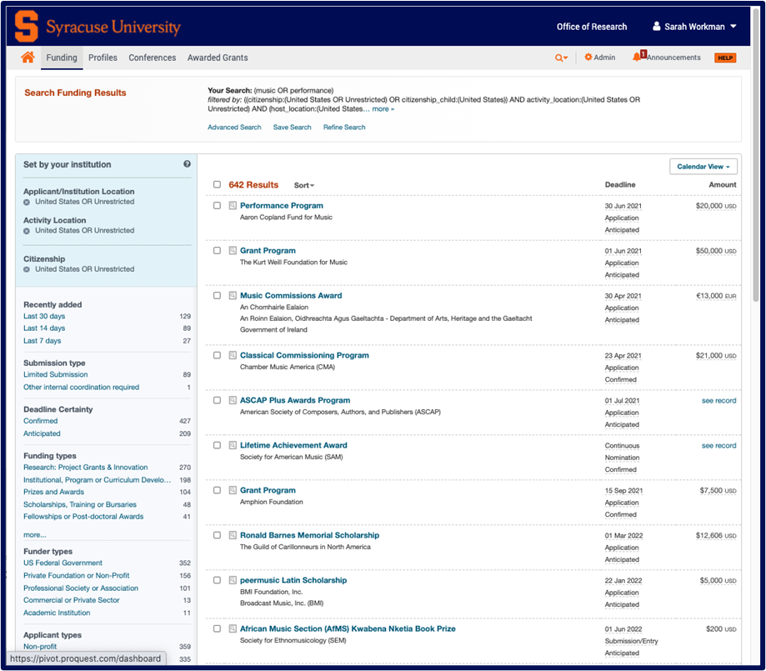
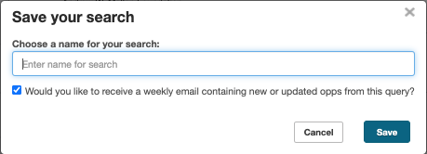
Navigating PIVOT: Save Your Search
Click “Save search” to save your search.
Choose a name for your search.
Check box if you would like to receive a weekly email containing new or updated opps from this query.
Notes:
Christina

Slide 31
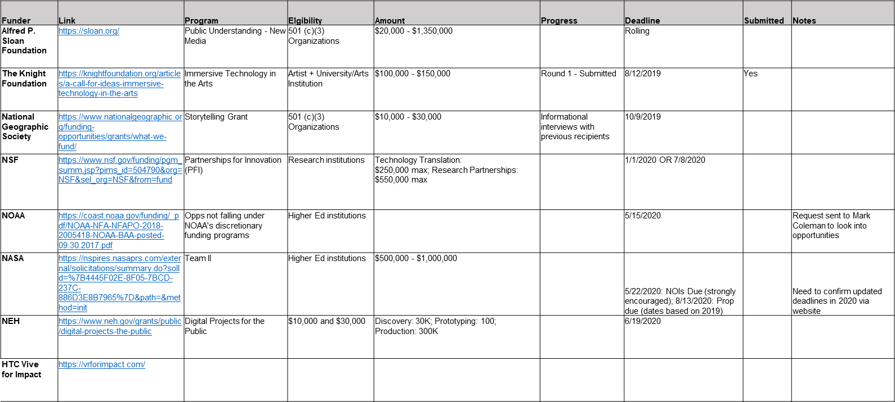
Example Funding Opps data table (don’t recreate the wheel each time!)
Notes:
Christina

Slide 32
Q & A

Slide 33
Contact Me2
Sarah Workman
Assistant Director, Research Development (Humanities)
srworkma@syr.edu
3-5260
202 Tolley Building

