Slide 1
Mellon New Directions
Budget Workshop
LeKita Scott Dawkins, Office of Foundation Relations
Sarah Workman, College of Arts & Sciences and Office of Research
Christina Leigh Docteur, Office of Research
Notes:
Vivian introductions then to Sarah

Slide 2
Syracuse University Application Portal
Main portal for all competitions: Http://Syracuse.infoready4.com
Link to Mellon New Directions application
Notes:
Sarah

Slide 3
Budget Terminology
From handout:
  Allowable costs
  Budget narrative (aka budget justification)
  Disallowed costs (aka unallowable costs)
  Fiscal year
  Letter of support or commitment
  Private foundation
  Terms of award
  Timeline
Notes:
LeKita

Slide 4
Budget in General
From handout:
  Items allowed
    Travel, equipment, materials & supplies, consultants, personnel, publications, stipends
  Budget narratives
    Details regarding each budget item
  Budget timeline
    For you to decide – project year, project period?
Notes:
LeKita

Slide 5
Stipulations for Mellon Budget
No overhead
Up to one academic year salary & two summers of additional support (2/9)
Mellon expects any needed equipment/research assistants to be covered by the institution
Up to 3 yr project period, range $175,000 - $250,000 (max $300,000)
Additional stipulations in template
Mellon may request budget modifications – get help from OSP! http://sponsoredprograms.syr.edu/about/contact/
Notes:
Christina
Reference budget template
Reference redacted

Slide 6
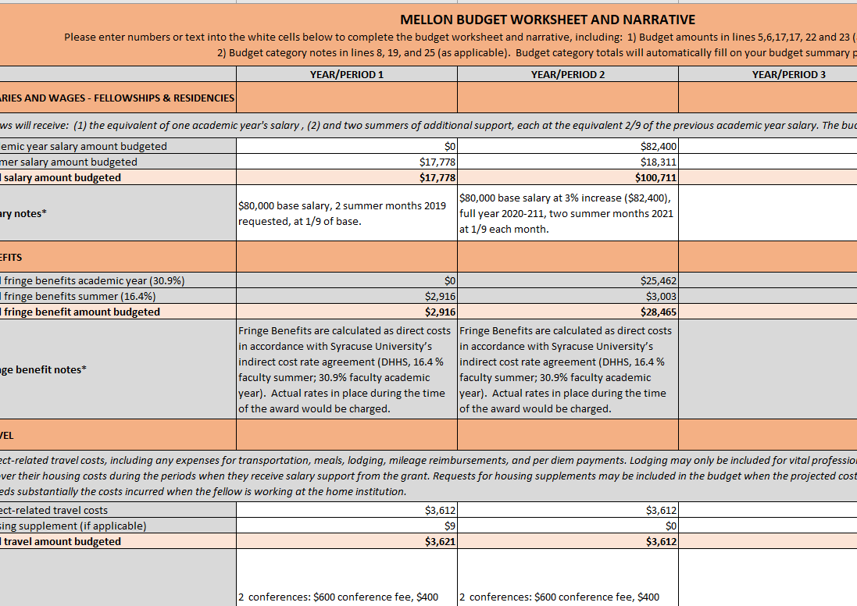
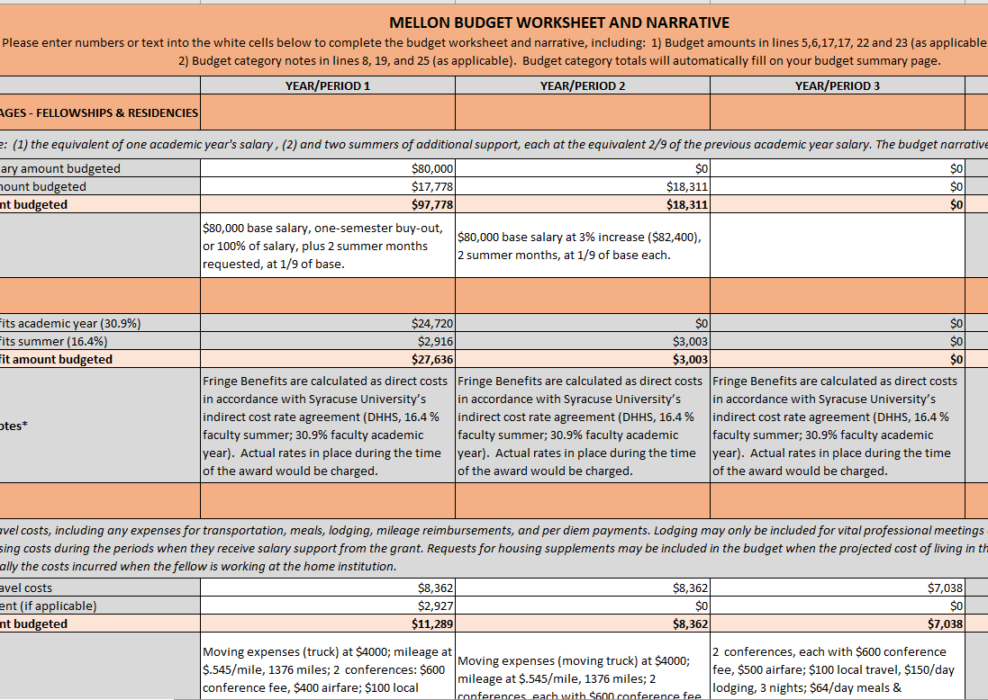
Budget Examples
Simplistic
Complex
Notes:
Christina
What to include with the budget
Example items in each category
Refer to the narrative clues provided for each category [SPLIT SCREENS]
Allowed to budget across three years, but do not have to
Can have a combination of summer support and an academic year spread across multiple years, or lumped in a single year
Walk through each budget category
Of note: In an effort to continue to address access issues that may have resulted from the COVID-19 pandemic, there is a separate fund of up to $15,000 for access to collections that have not yet been digitized and cataloged, or require the paid support of a librarian or archivist to assist with research where collections are closed to outside visitors. Please enter the request for this support in the budget category “Consultants and Professional Services.”

Slide 7
Deadline
Limited Submission Deadline: Monday, August 9th
Mellon Deadline: Noon on Friday, September 24th, 2021
Contacts for questions:
LeKita Scott Dawkins, Office of Foundation Relations
ldawkins@syr.edu
Sarah Workman, Assistant Director of Research Development, Humanities
srworkma@syr.edu

