Slide 1
Turning your Dissertation into a Book (and Finding a Publisher!)
Where to Begin

Slide 2
Should you write your dissertation like a book?
No
And/or
Yes

Slide 3
Audience
The audience for your dissertation is, and should be, your committee.
What does it mean to write for a wider audience?

Slide 4
Length and Structure
Work on your introductions and conclusions, over and over again.
Make sure your chapters are even.
It needs to make sense as a whole.
How long should your manuscript be?

Slide 5
Some concrete steps:
Don’t forget to allow yourself time!
Consider your target audience(s) and then write for them. Imagine actual people picking up and reading your book!
Try to reverse outline your dissertation to identify major arguments and themes
Cut any literature review sections or chapters. Cut any unnecessary references that don’t support your arguments. Cut unnecessary notes.
Remove “I” statements – “I will argue” or “this manuscript will argue.”
Work on something that isn’t your manuscript – a journal article, a personal journal, an opinion piece, anything! Spend some time building confidence in yourself and your writing.

Slide 6
Some Resources
Books:
From Dissertation to Book, William Germano
Revising Your Dissertation, Beth Luey
Getting It Published, William Germano
Articles/Websites:
Language and Philosophy.com: From Dissertation to Published Book
University of Washington: Turning your Dissertation into a Book
APA.org: Publishing Your Dissertation
UNC Press: Dissertation to Book
Palgrave.com: Advice from our Editors: Revising the Dissertation into a Monograph
Inside Higher Ed: Why You Shouldn’t Immediately Convert Your Dissertation

Slide 7
Finding a Publisher
Finding the right fit
Approaching an Acquisitions Editor
Sending a proposal

Slide 8
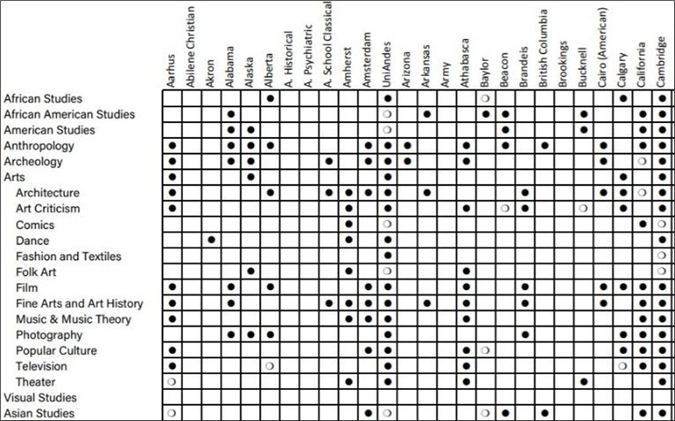
Use the AUPresses Subject Area Grid to find the right publisher for you:
The subject area grid shows all of the subject areas (listed vertically) that each member press (across the top) publishes. AUPresses Subject Area Grid

Slide 9
Finding a Publisher
Finding the right fit
Approaching an Acquisitions Editor
Sending a proposal

Slide 10
What is your idea (AKA, How to pitch your book)
The first book to investigate X
The first book to bring together X and Y
The first theoretical treatment of X
An in-depth understanding of X
A behind-the-scenes accounting of X
A policy-relevant topic that offers ways to create meaningful social change
The most important/authoritative/recent account of X
The best method/research for understanding X

Slide 11
More Resources
Association of University Presses:
Finding a Publisher
Subject Area Grid
Ask UP: Authors Seeking Knowledge from University Presses

Slide 12
Ask UP
Visit Ask UP:
ask.up.hcommons.org

Slide 13
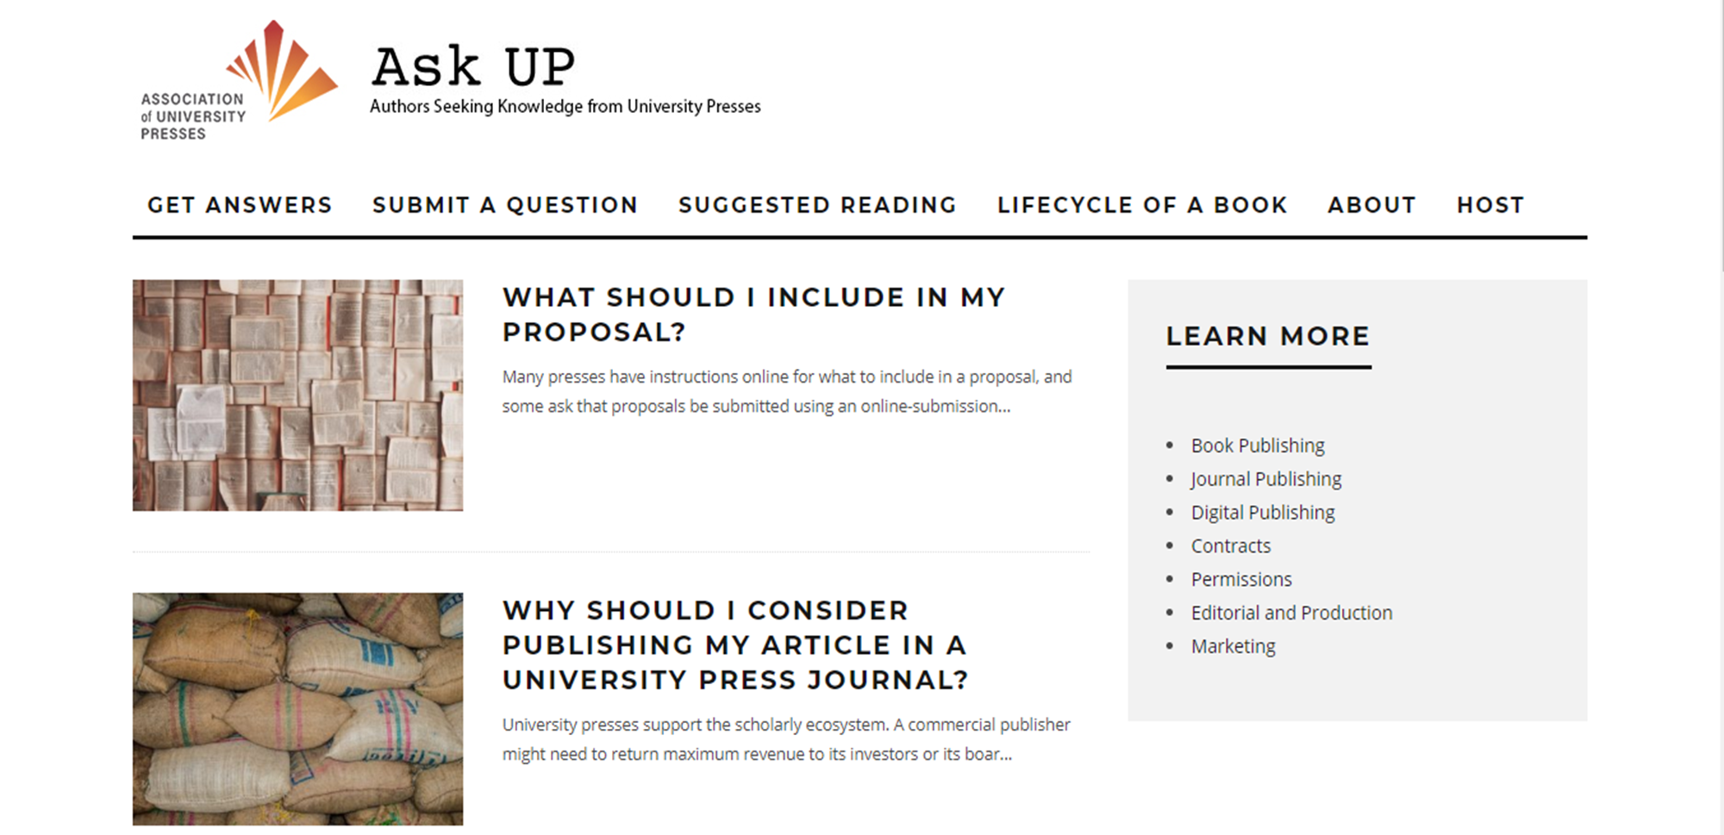
Ask UP (cont.)

