Slide 1
Demystifying the Book Publication Process
From Peer Review to Published Author

Slide 2
The Publication Process
Your book travels through three departments to go from proposal to publication
Acquisitions
Editorial, Design, and Production (EDP)
Marketing

Slide 3
Acquisitions
Author submits proposal to the press
Press agrees to send either the proposal or the full manuscript out for peer review
Author receives reviews and writes a response letter
Press presents project to Editorial Board for final approval
Contract is sent to author with a final manuscript deadline
Author revises
Press may need to send project for peer review again
Author submits final materials

Slide 4
Peer Review
Full manuscript gets sent out to 2 expert peer readers
Can take anywhere from 3-6 months
Is a conversation

Slide 5
Editorial Boards
Comprised of faculty and staff at the press’ university
Approve manuscripts for publication

Slide 6
Editorial, Design, and Production
Final materials are given to production (including any images and permissions)
Manuscript is copy edited; author reviews/approves changes
Cover design and interior design occurs
Manuscript is typeset for proofreading, indexing, and final author review
Book is printed and shipped
Ebook is created

Slide 7
Marketing
Author fills out a marketing questionnaire
Backorders of the print book are shipped
Review copies are sent out
Promotion continues for the life of the project, but the first year is important
Reviews, exhibits, awards, ads, and other promotion campaigns
Granting of rights (reprint, translation, audio) and course adoptions may follow

Slide 8
Ask UP
Visit Ask UP:
ask.up.hcommons.org

Slide 9
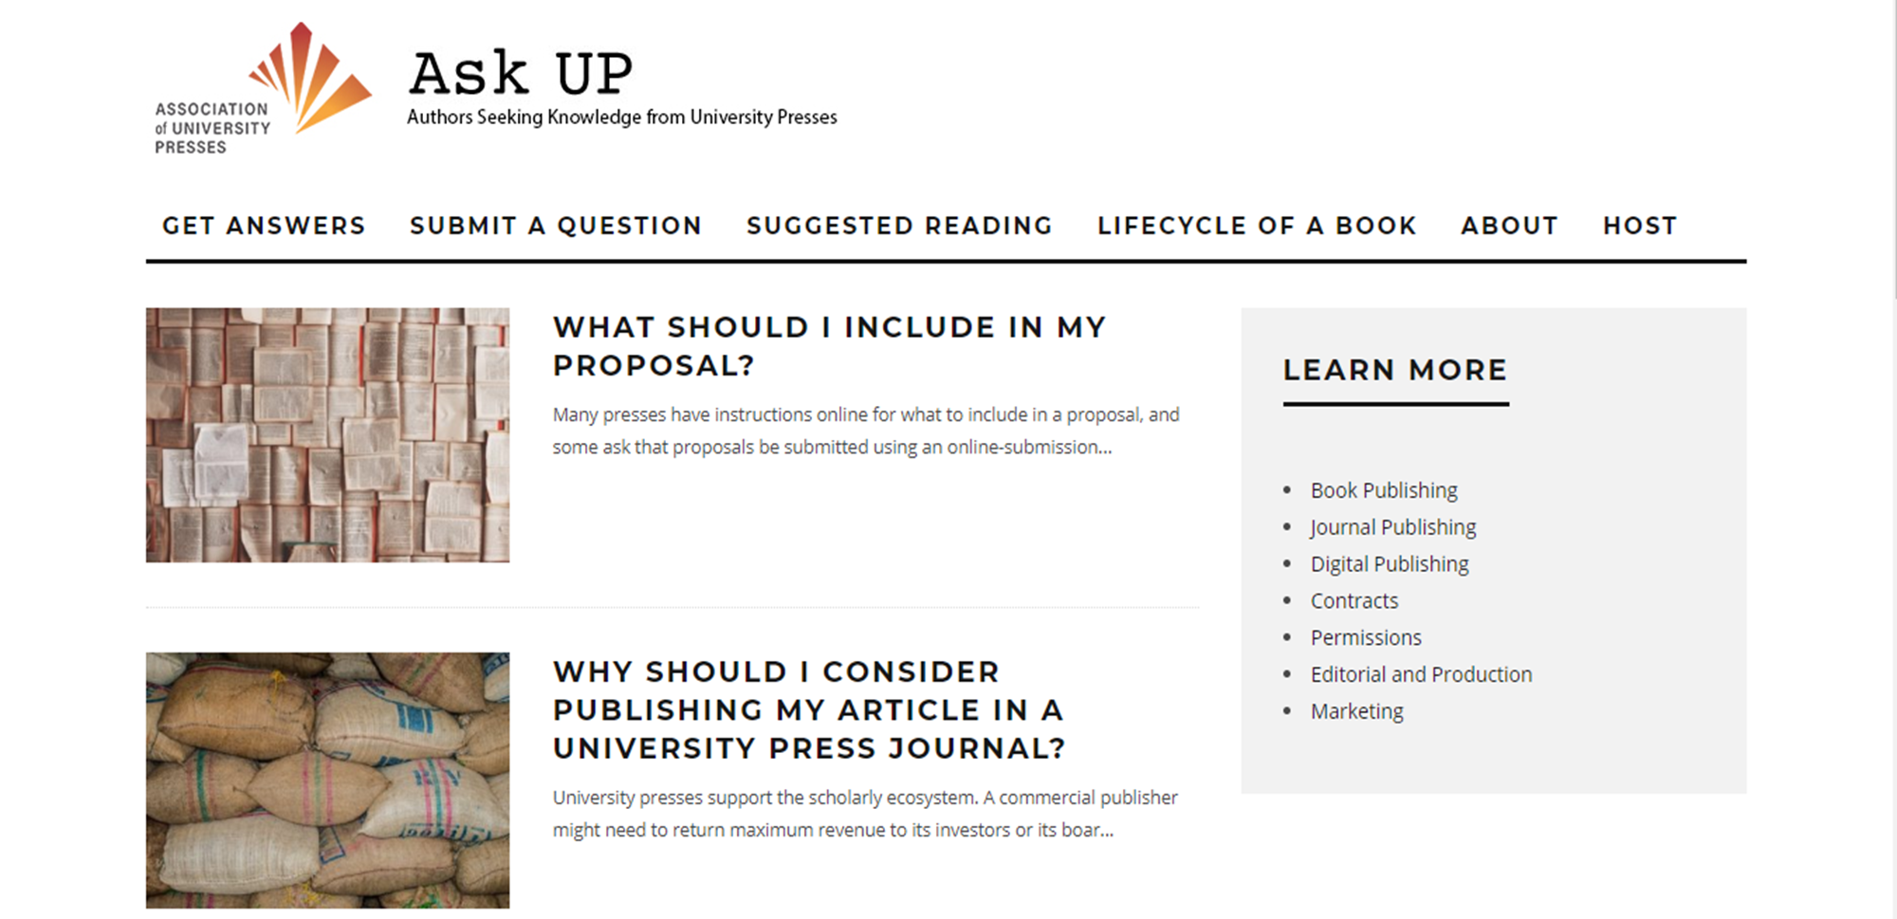
Ask UP (cont.)

